Slide 1
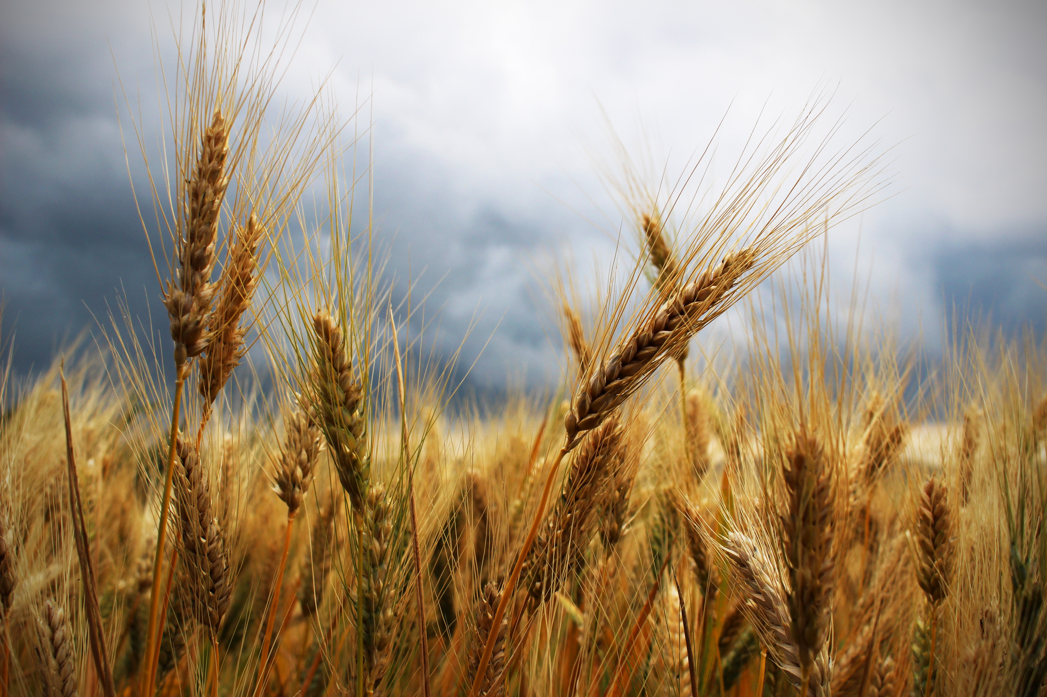
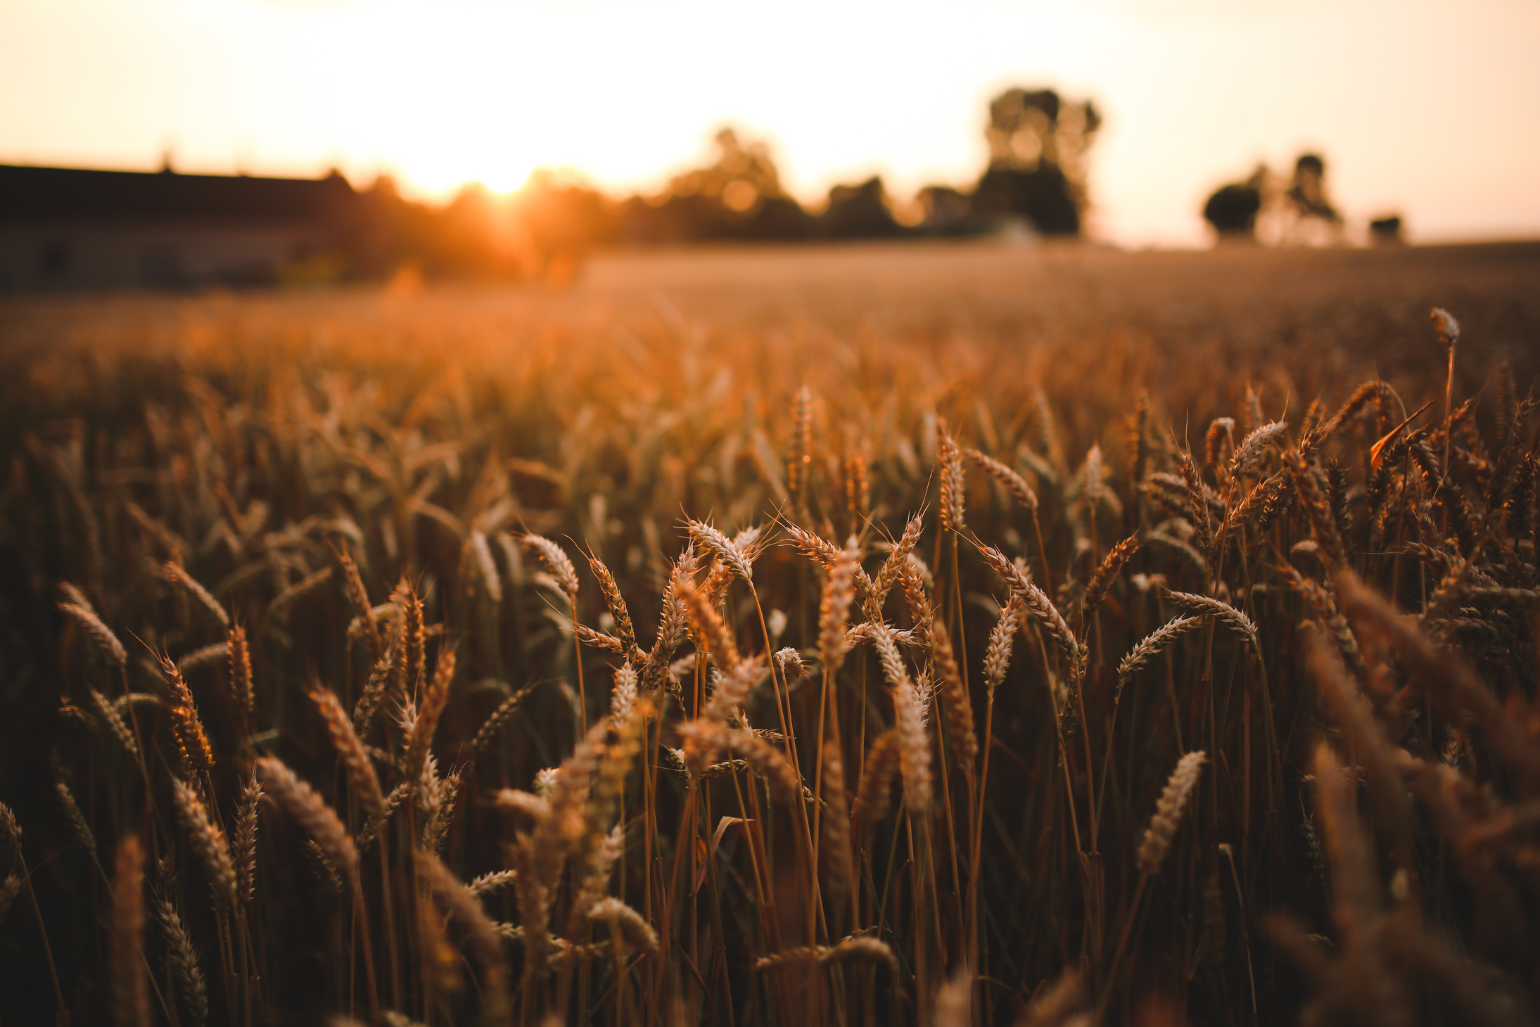
AGENDA
ABSTRACT
INTRODUCTION
RESEARCH QUESTIONS
METHODOLOGY
DATASET
EXPLORATORY DATA ANALYSIS
MODEL EVALUATION
FUTURE ENHANCEMENT
REFERENCES
Smart Soil Crop Recommender Dataset
01

Slide 2


ABSTRACT
02
AGENDA
ABSTRACT
INTRODUCTION
RESEARCH QUESTIONS
METHODOLOGY
DATASET
EXPLORATORY DATA ANALYSIS
MODEL EVALUATION
FUTURE ENHANCEMENT
REFERENCES
01
The "Smart Soil Crop Recommender Dataset" project is designed to assist in making data-driven agricultural decisions by recommending suitable crops based on soil characteristics. This project aims to empower farmers with accurate, region-specific recommendations to enhance crop yields and ensure efficient resource utilization. The presentation outlines the dataset's composition, the analytical methods employed, and the project's anticipated impact on modern agriculture.

Slide 3
Agriculture is a cornerstone of human civilization, and its productivity is heavily influenced by soil quality and nutrient availability. The "Smart Soil Crop Recommender Dataset" project focuses on developing an intelligent system to support farmers in selecting the most suitable crops for their soil conditions. The dataset used includes 620 observations of soil samples, capturing critical features like macronutrients (N, P, K), pH levels, electrical conductivity (EC), sulphur (S), and trace elements (Cu, Fe, Mn, Zn, B). These data points are labeled with corresponding crops, such as pomegranate, ragi, and mulberry.
This project combines advanced data analysis and machine learning techniques to build a recommendation model that integrates agricultural science with modern technology. The primary objective is to provide accurate crop recommendations, improve farming efficiency, and minimize environmental impacts.
ABSTRACT
AGENDA
INTRODUCTION
The "Smart Soil Crop Recommender Dataset" project is designed to assist in making data-driven agricultural decisions by recommending suitable crops based on soil characteristics. This project aims to empower farmers with accurate, region-specific recommendations to enhance crop yields and ensure efficient resource utilization. The presentation outlines the dataset's composition, the analytical methods employed, and the project's anticipated impact on modern agriculture.
ABSTRACT
INTRODUCTION
RESEARCH QUESTIONS
METHODOLOGY
DATASET
EXPLORATORY DATA ANALYSIS
MODEL EVALUATION
CONCLUSION
FUTURE ENHANCEMENT
REFERENCES
01
03
02

Slide 4
ABSTRACT
02
RESEARCH QUESTIONS
03
INTRODUCTION
Which crops are best suited for different soil nutrient levels ?
Agriculture is a cornerstone of human civilization, and its productivity is heavily influenced by soil quality and nutrient availability. The "Smart Soil Crop Recommender Dataset" project focuses on developing an intelligent system to support farmers in selecting the most suitable crops for their soil conditions. The dataset used includes 620 observations of soil samples, capturing critical features like macronutrients (N, P, K), pH levels, electrical conductivity (EC), sulphur (S), and trace elements (Cu, Fe, Mn, Zn, B). These data points are labeled with corresponding crops, such as pomegranate, ragi, and mulberry.
This project combines advanced data analysis and machine learning techniques to build a recommendation model that integrates agricultural science with modern technology. The primary objective is to provide accurate crop recommendations, improve farming efficiency, and minimize environmental impacts.
What is the relationship between nitrogen levels and different crop types?
Which nutrients are most critical for specific crops?
How can farmers improve their crop selection based on soil health?
How can farmers improve their crop selection based on soil health?
03
The "Smart Soil Crop Recommender Dataset" project is designed to assist in making data-driven agricultural decisions by recommending suitable crops based on soil characteristics. This project aims to empower farmers with accurate, region-specific recommendations to enhance crop yields and ensure efficient resource utilization. The presentation outlines the dataset's composition, the analytical methods employed, and the project's anticipated impact on modern agriculture.
05
04

Slide 5

Visualizations
INTRODUCTION
RESEARCH QUESTIONS
Agriculture is a cornerstone of human civilization, and its productivity is heavily influenced by soil quality and nutrient availability. The "Smart Soil Crop Recommender Dataset" project focuses on developing an intelligent system to support farmers in selecting the most suitable crops for their soil conditions. The dataset used includes 620 observations of soil samples, capturing critical features like macronutrients (N, P, K), pH levels, electrical conductivity (EC), sulphur (S), and trace elements (Cu, Fe, Mn, Zn, B). These data points are labeled with corresponding crops, such as pomegranate, ragi, and mulberry.
This project combines advanced data analysis and machine learning techniques to build a recommendation model that integrates agricultural science with modern technology. The primary objective is to provide accurate crop recommendations, improve farming efficiency, and minimize environmental impacts.
Data Preprocessing
Data Collection
01
Which crops are best suited for different soil nutrient levels ?
02
What is the relationship between nitrogen levels and different crop types ?
03
Which nutrients are most critical for specific crops ?
Ensembling Techniques
04
How can farmers improve their crop selection based on soil health ?
05
How can farmers improve their crop selection based on soil health ?
Model Implementation

Slide 6
Dataset
METHODOLOGY
Source of the Dataset: crop-recommendation-dataset
No.of Observations : 620 rows & 12 columns
Features Details : N (Nitrogen): Essential for plant growth, promoting leafy development and overall health, P (Phosphorus): Supports root development and flower/fruit production in plants, K (Potassium): Enhances drought resistance, disease resistance, and overall plant vigor, ph: Indicates soil acidity or alkalinity, affecting nutrient availability to plants, EC (Electrical Conductivity): Measures soil salinity and the ability to conduct electrical current, which influences nutrient absorption, S (Sulfur): Key for protein synthesis and chlorophyll formation in plants, Cu (Copper): Vital for enzymatic processes and the formation of chlorophyll, Fe (Iron): Critical for chlorophyll synthesis and enzymatic reactions in plants, Mn (Manganese): Important for photosynthesis and nitrogen metabolism in plants, Zn (Zinc): Supports plant growth by aiding in hormone production and enzyme activation, B (Boron): Essential for cell wall formation and reproductive growth in plants, label in the dataset represents the specific crop associated with the given soil properties, such as pomegranate, ragi, or mulberry.
Details about the columns : Discrete & categorical
Data Collection
Data Preprocessing
Visualizations
Ensembling Techniques
Model Implementation
04

Slide 7
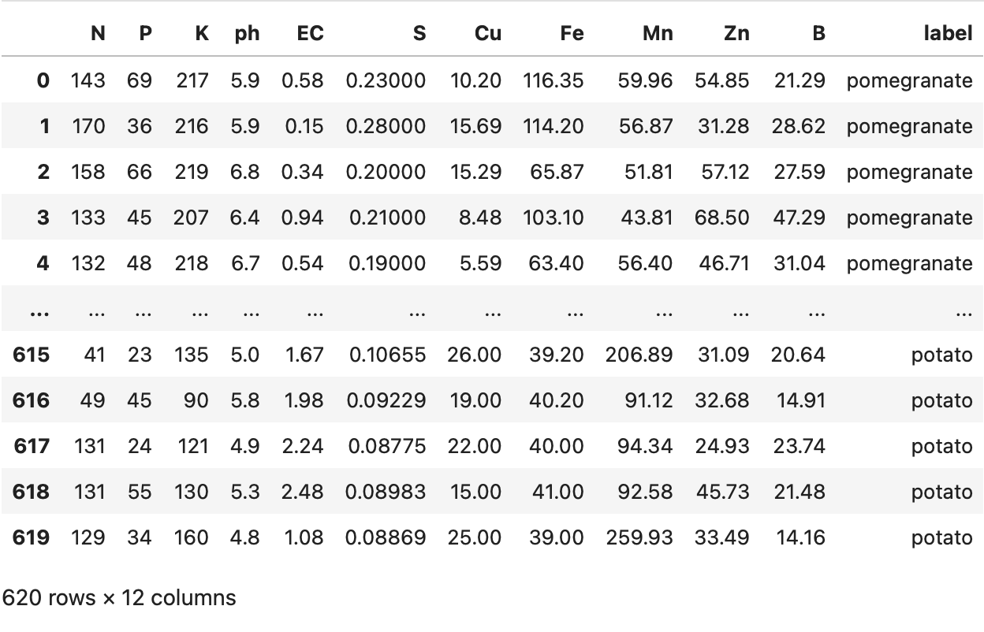
Visualizations
Screenshot of the Dataset
Dataset
Source of the Dataset: crop-recommendation-dataset
No.of Observations : 620 rows & 12 columns
Features Details : N (Nitrogen): Essential for plant growth, promoting leafy development and overall health, P (Phosphorus): Supports root development and flower/fruit production in plants, K (Potassium): Enhances drought resistance, disease resistance, and overall plant vigor, ph: Indicates soil acidity or alkalinity, affecting nutrient availability to plants, EC (Electrical Conductivity): Measures soil salinity and the ability to conduct electrical current, which influences nutrient absorption, S (Sulfur): Key for protein synthesis and chlorophyll formation in plants, Cu (Copper): Vital for enzymatic processes and the formation of chlorophyll, Fe (Iron): Critical for chlorophyll synthesis and enzymatic reactions in plants, Mn (Manganese): Important for photosynthesis and nitrogen metabolism in plants, Zn (Zinc): Supports plant growth by aiding in hormone production and enzyme activation, B (Boron): Essential for cell wall formation and reproductive growth in plants, label in the dataset represents the specific crop associated with the given soil properties, such as pomegranate, ragi, or mulberry.
Details about the columns : Discrete & categorical
Data Preprocessing
Data Collection
Ensembling Techniques
05
Model Implementation

Slide 8
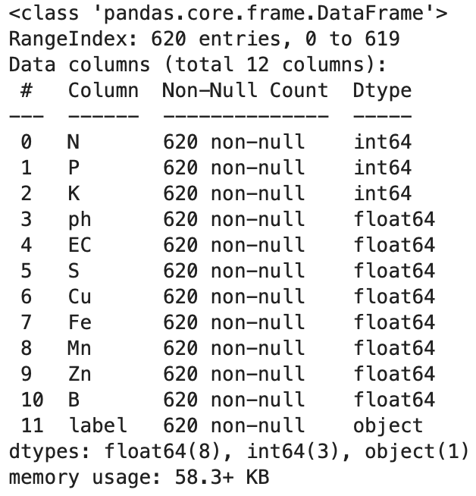
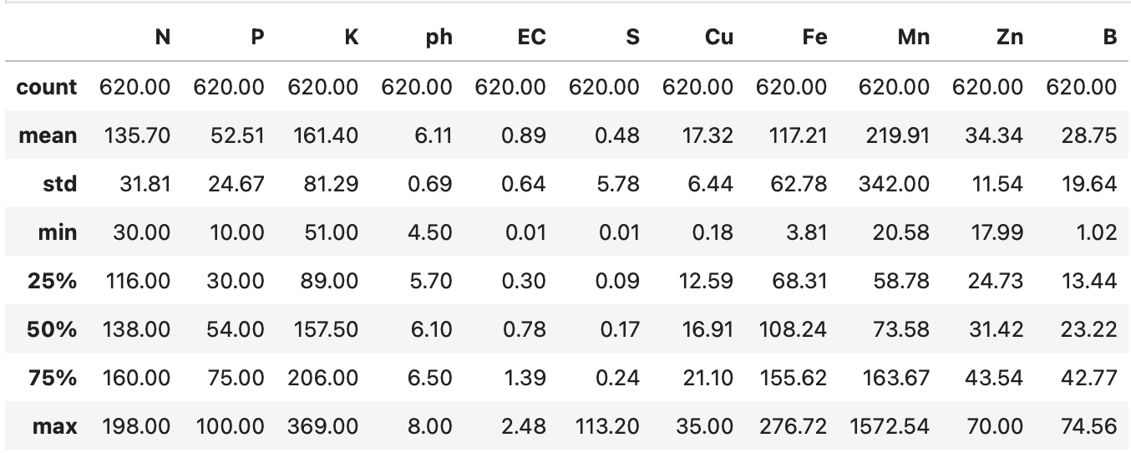
EXPLORATORY DATA ANALYSIS
Dataset
Source of the Dataset: crop-recommendation-dataset
No.of Observations : 620 rows & 12 columns
Features Details : N (Nitrogen): Essential for plant growth, promoting leafy development and overall health, P (Phosphorus): Supports root development and flower/fruit production in plants, K (Potassium): Enhances drought resistance, disease resistance, and overall plant vigor, ph: Indicates soil acidity or alkalinity, affecting nutrient availability to plants, EC (Electrical Conductivity): Measures soil salinity and the ability to conduct electrical current, which influences nutrient absorption, S (Sulfur): Key for protein synthesis and chlorophyll formation in plants, Cu (Copper): Vital for enzymatic processes and the formation of chlorophyll, Fe (Iron): Critical for chlorophyll synthesis and enzymatic reactions in plants, Mn (Manganese): Important for photosynthesis and nitrogen metabolism in plants, Zn (Zinc): Supports plant growth by aiding in hormone production and enzyme activation, B (Boron): Essential for cell wall formation and reproductive growth in plants, label in the dataset represents the specific crop associated with the given soil properties, such as pomegranate, ragi, or mulberry.
Details about the columns : Discrete & categorical
Screenshot of the Dataset
06

Slide 9
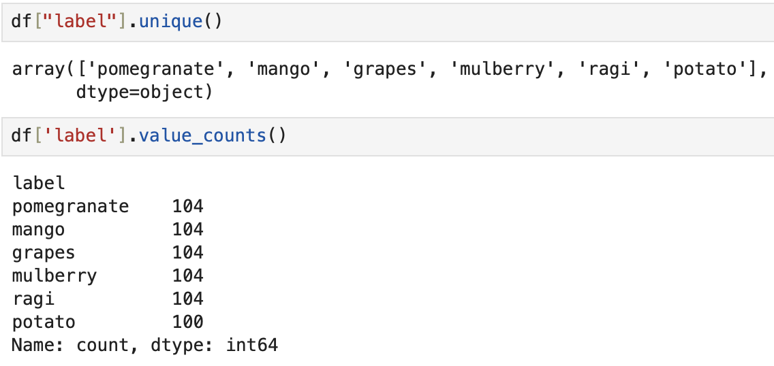
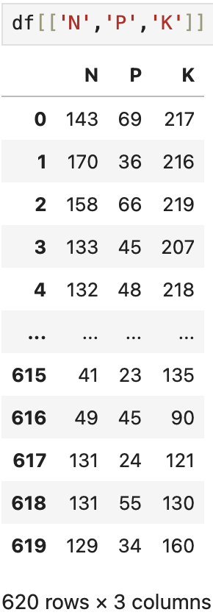
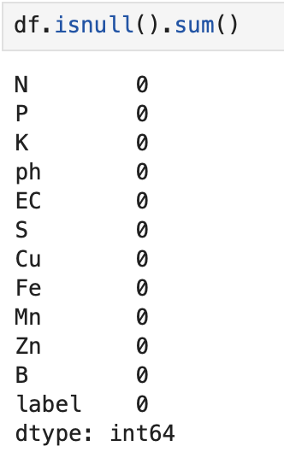
EXPLORATORY DATA ANALYSIS
07

Slide 10
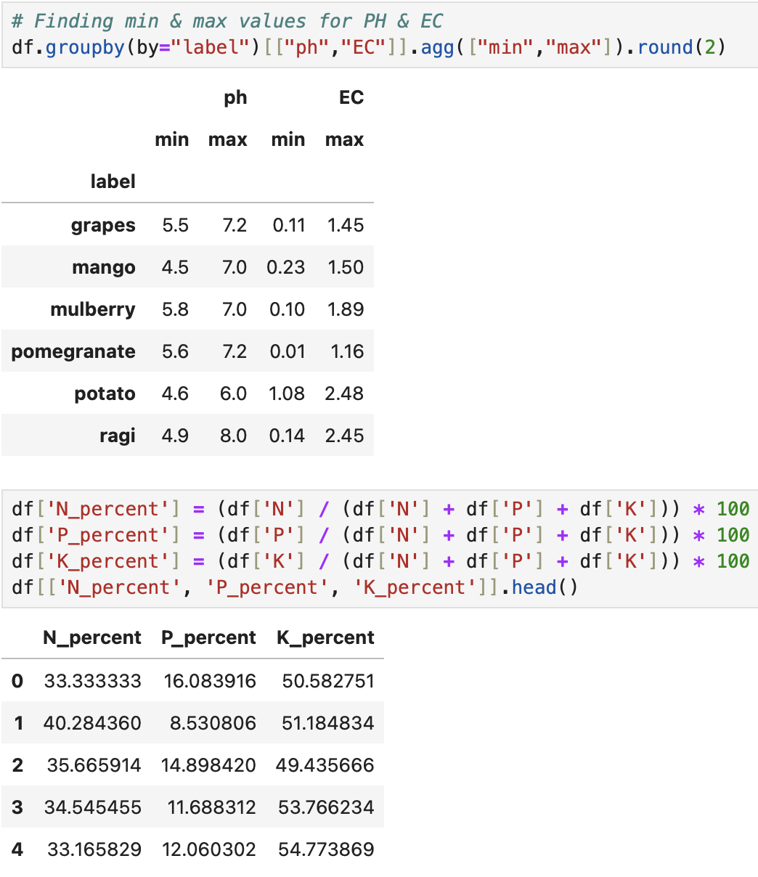
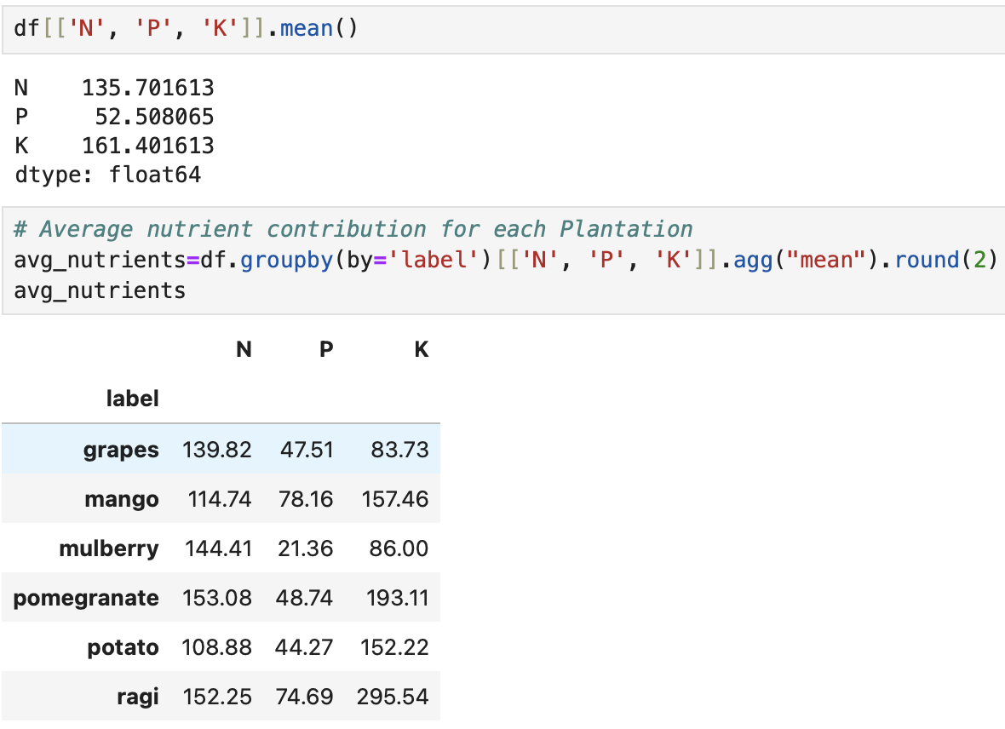
EXPLORATORY DATA ANALYSIS
08

Slide 11
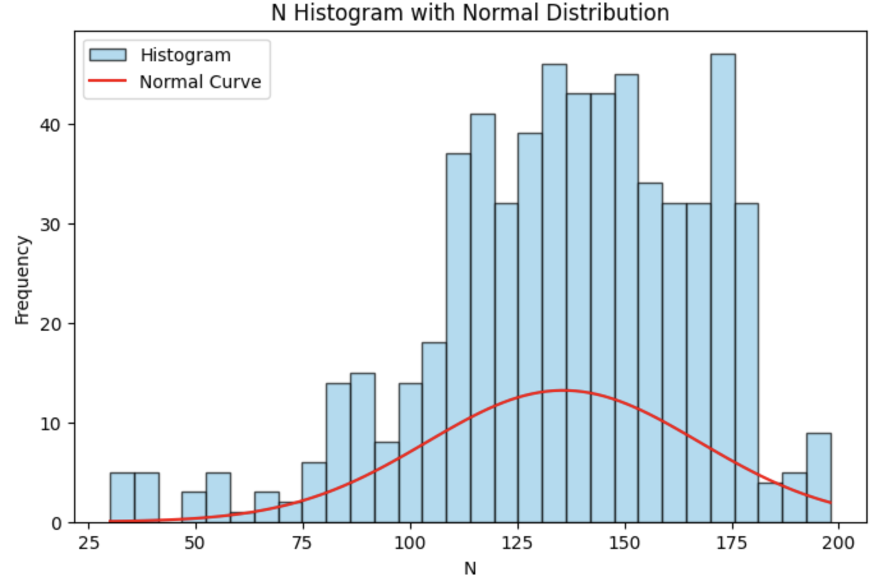
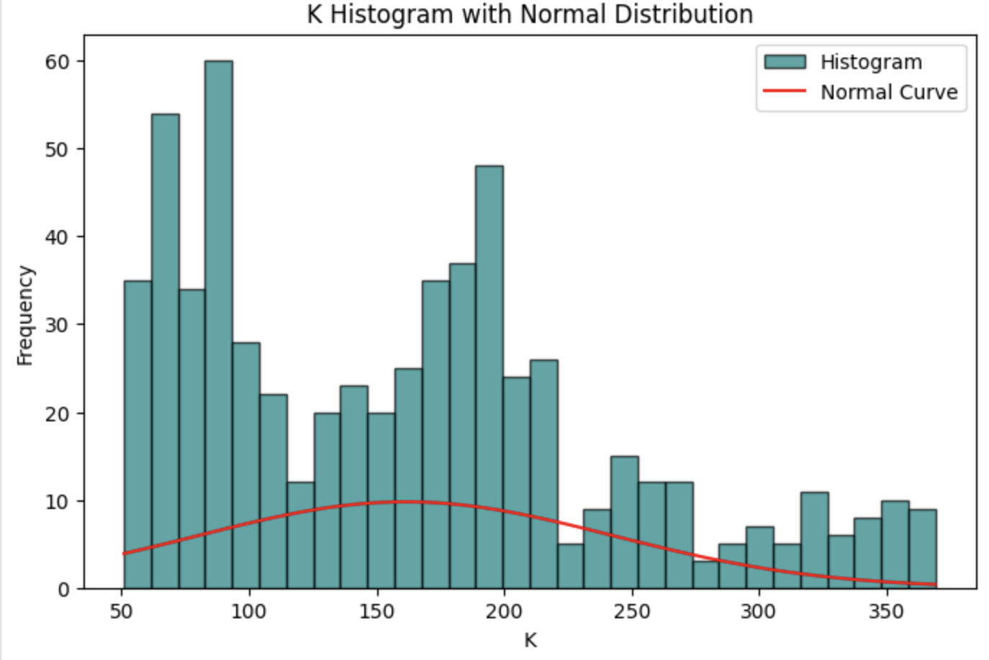
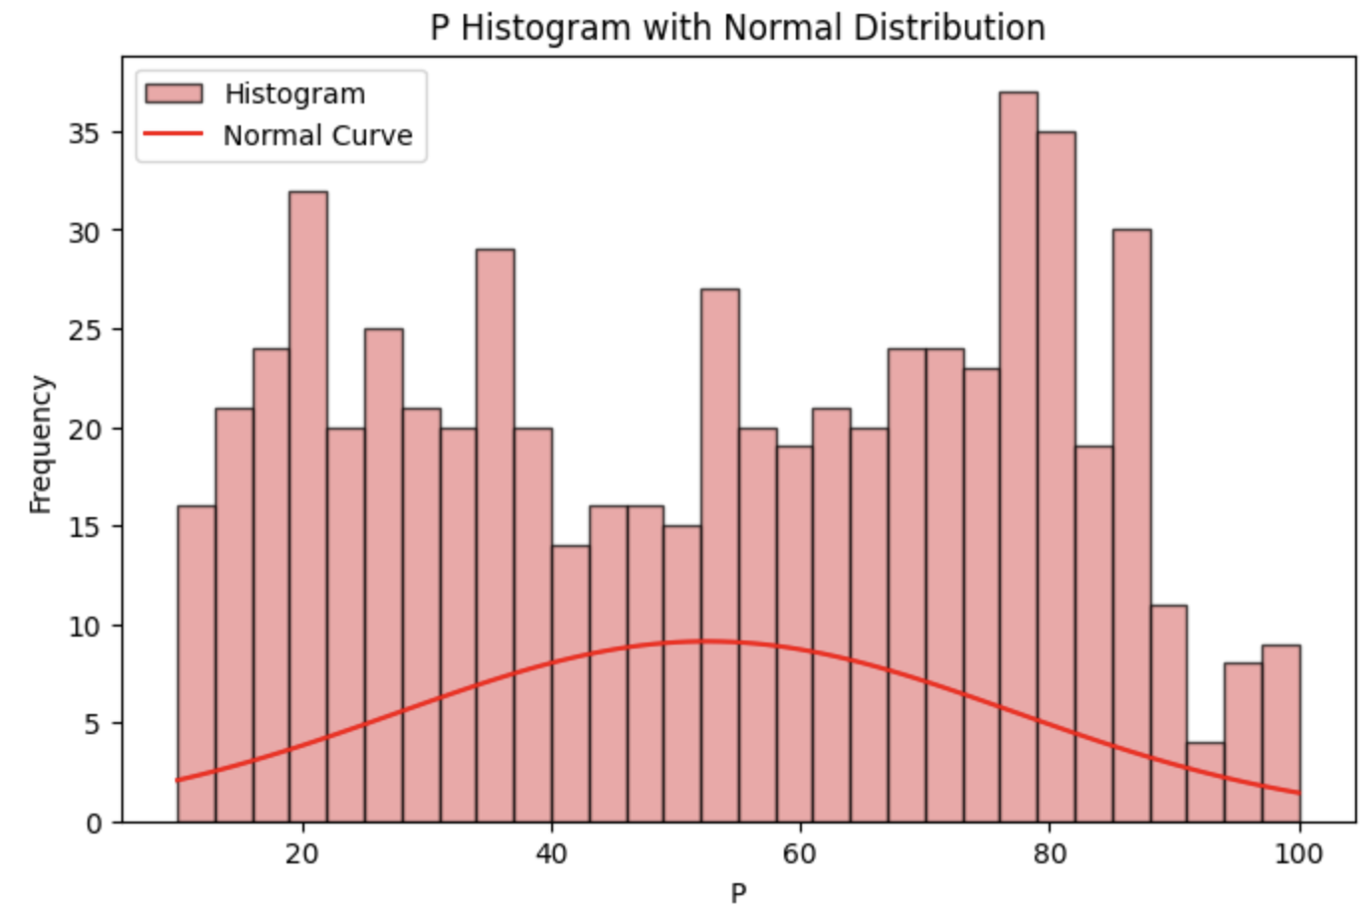
EXPLORATORY DATA ANALYSIS
09
Visualizations

Slide 12
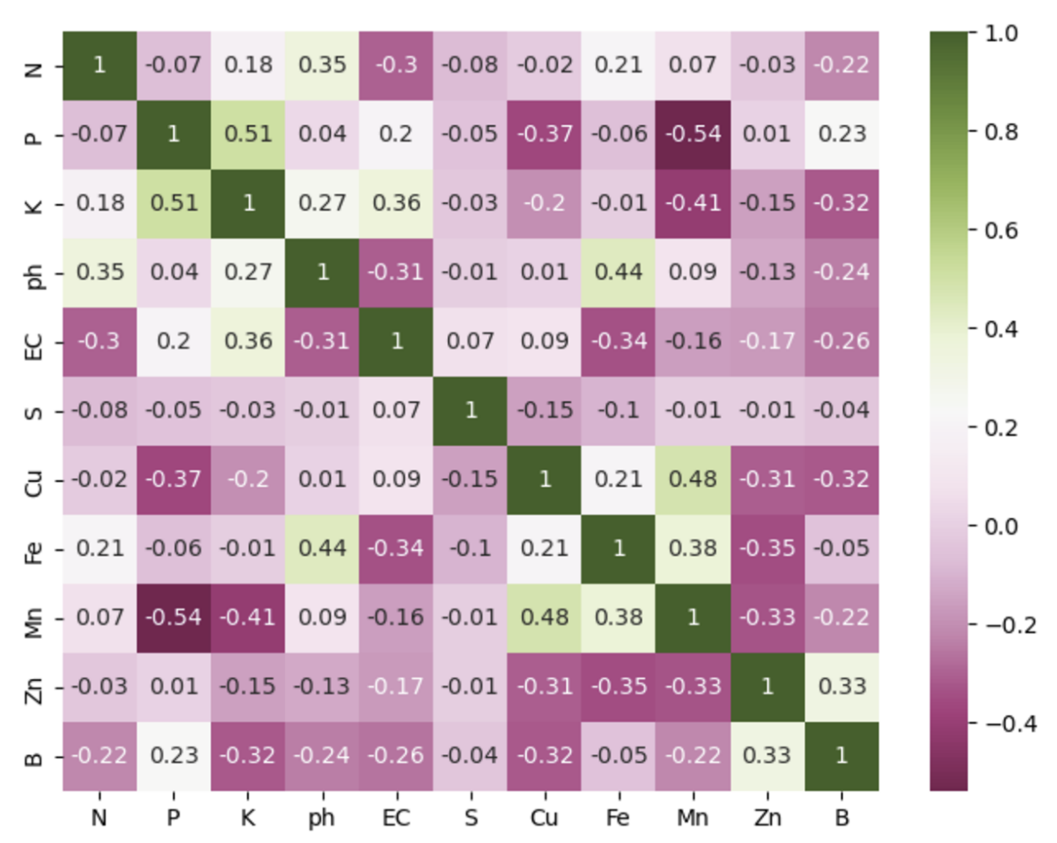
EXPLORATORY DATA ANALYSIS
Visualizations
10

Slide 13
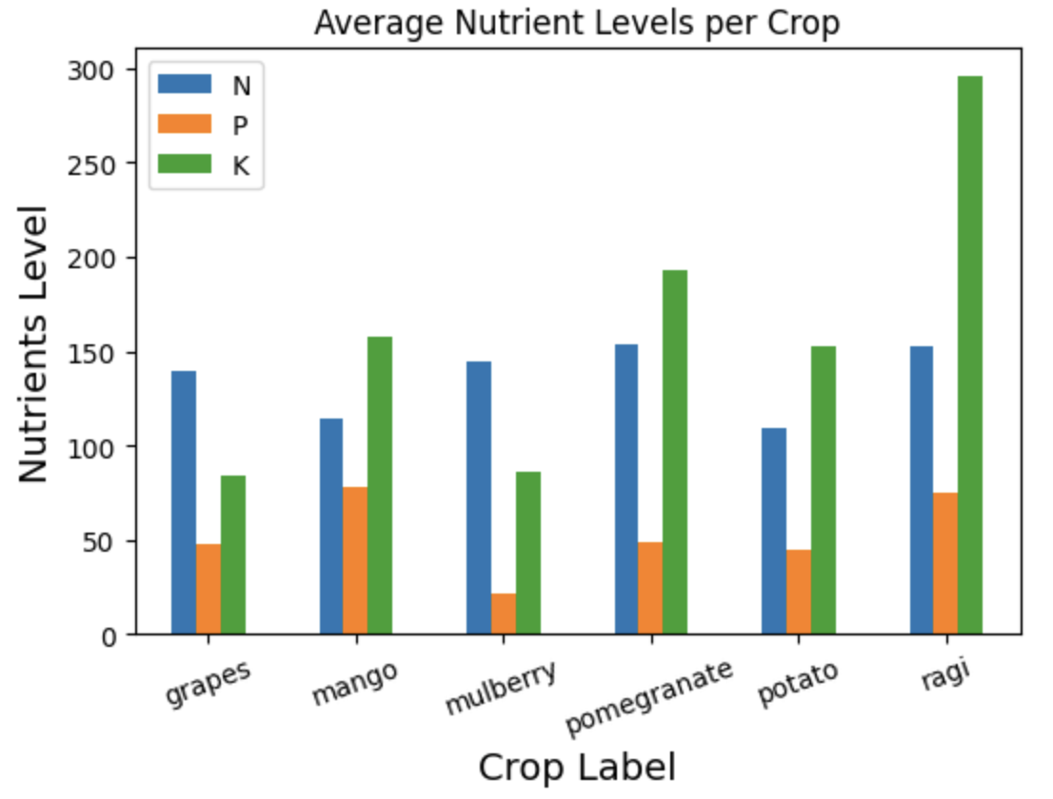
Visualizations
11

Slide 14
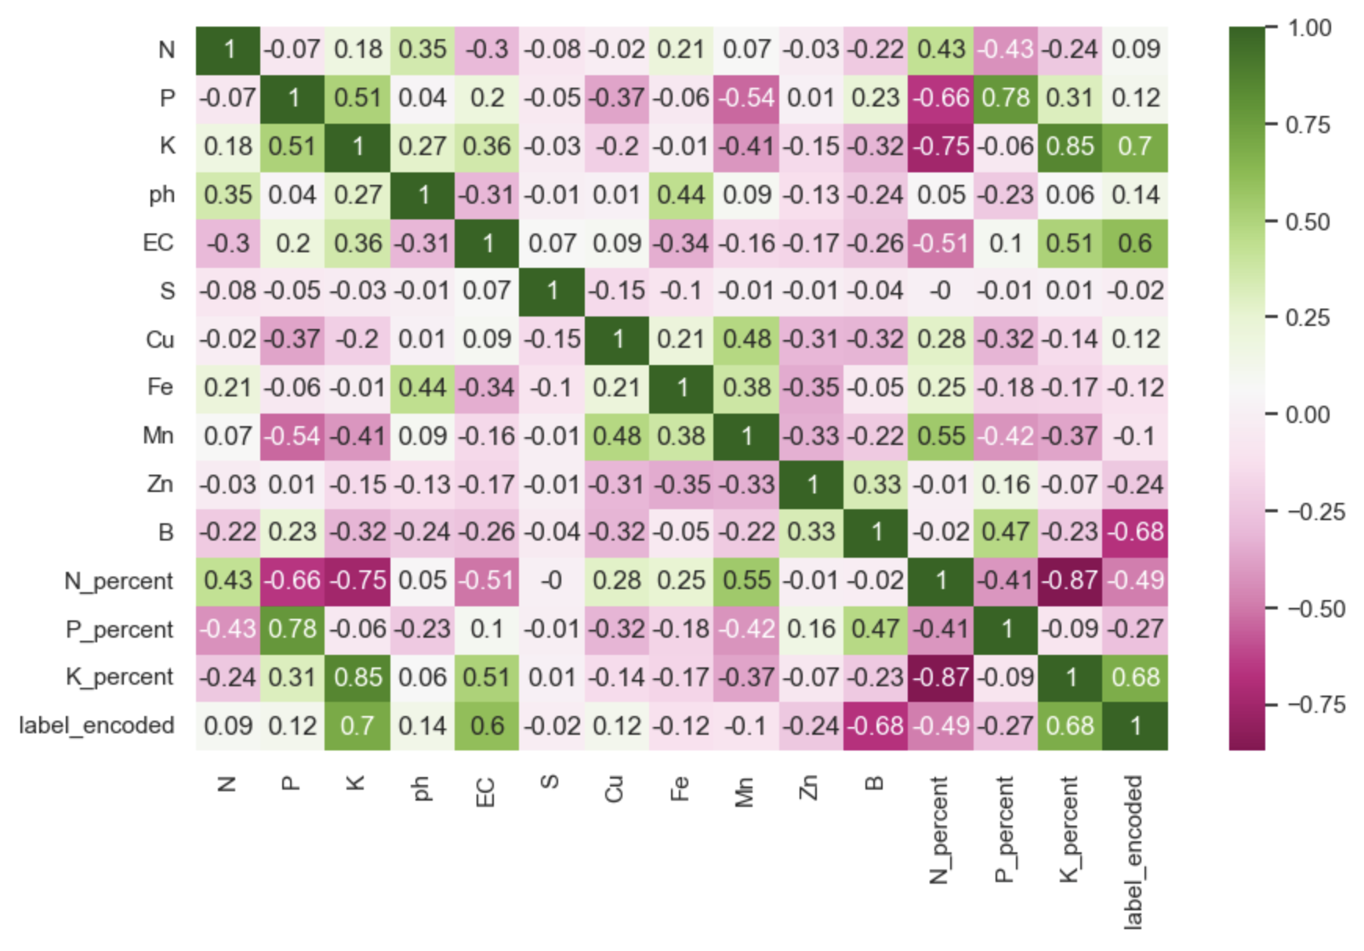
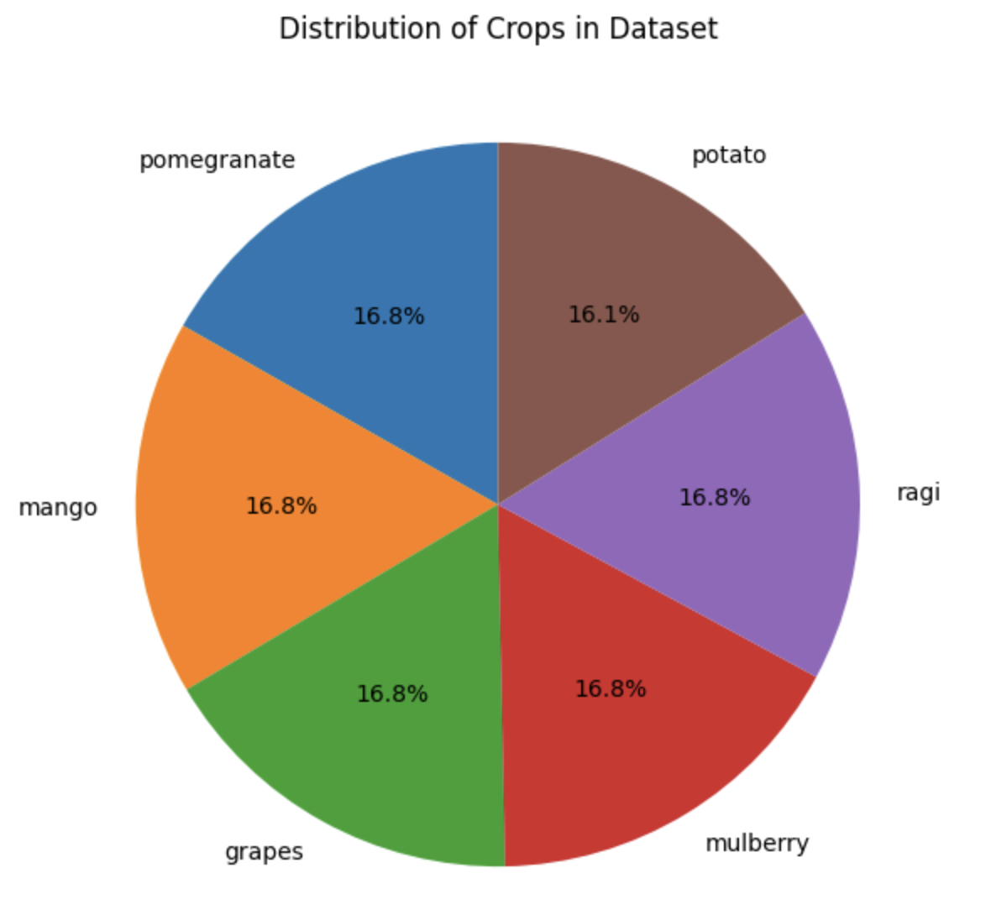
Visualizations
12

Slide 15
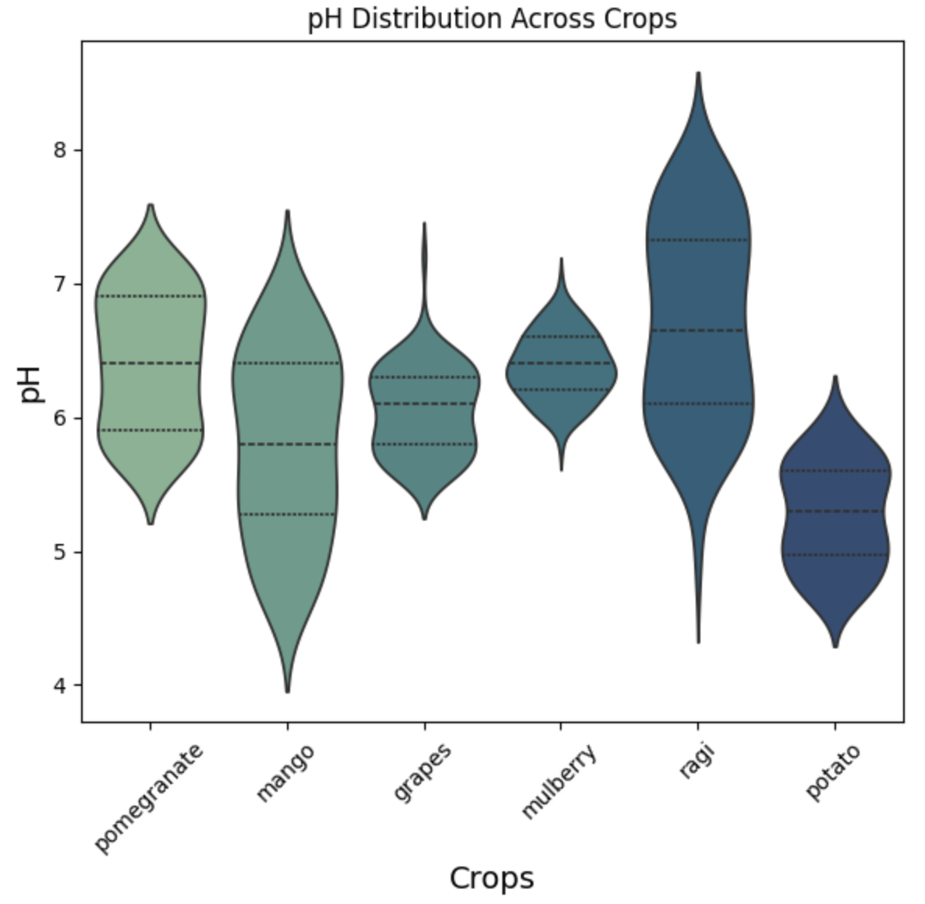
Visualizations
13

Slide 16
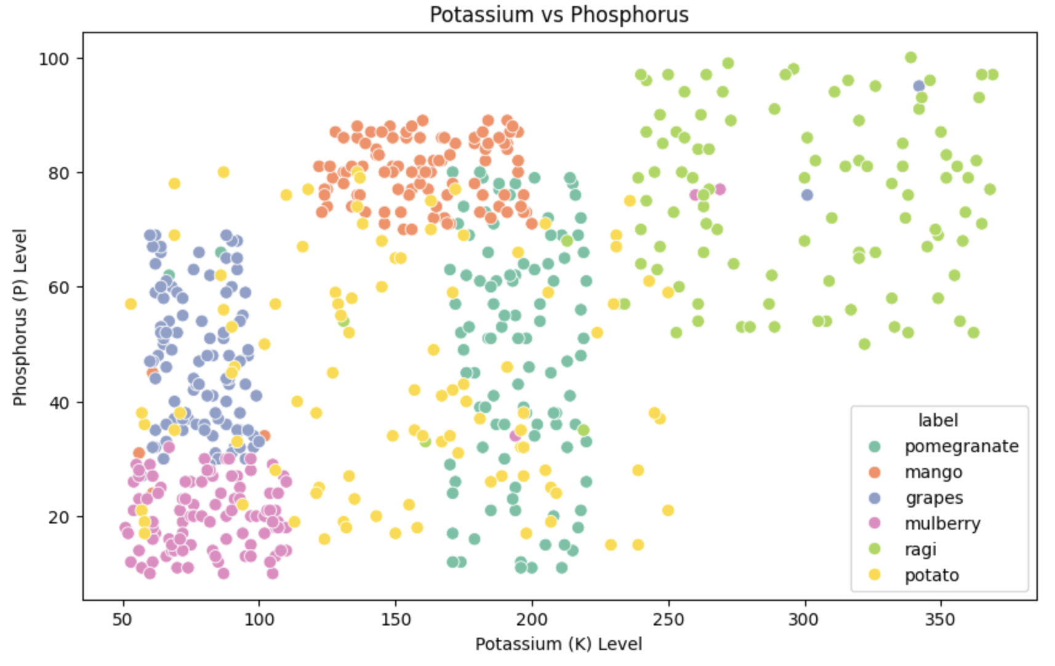
Visualizations
14

Slide 17
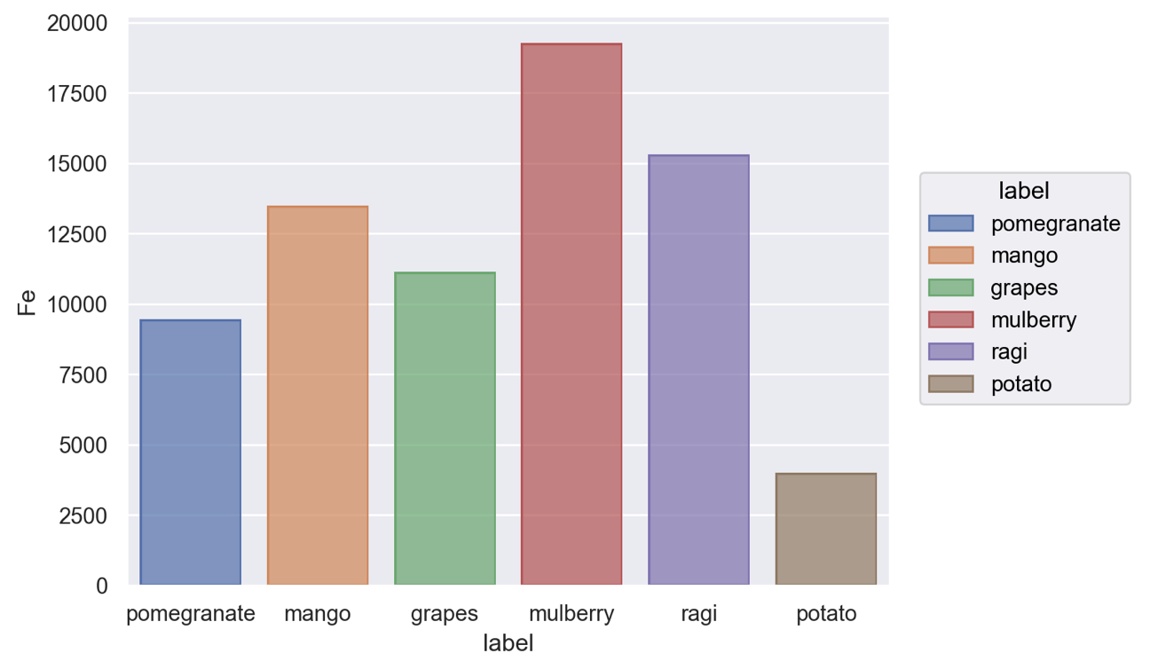
Visualizations
15

Slide 18
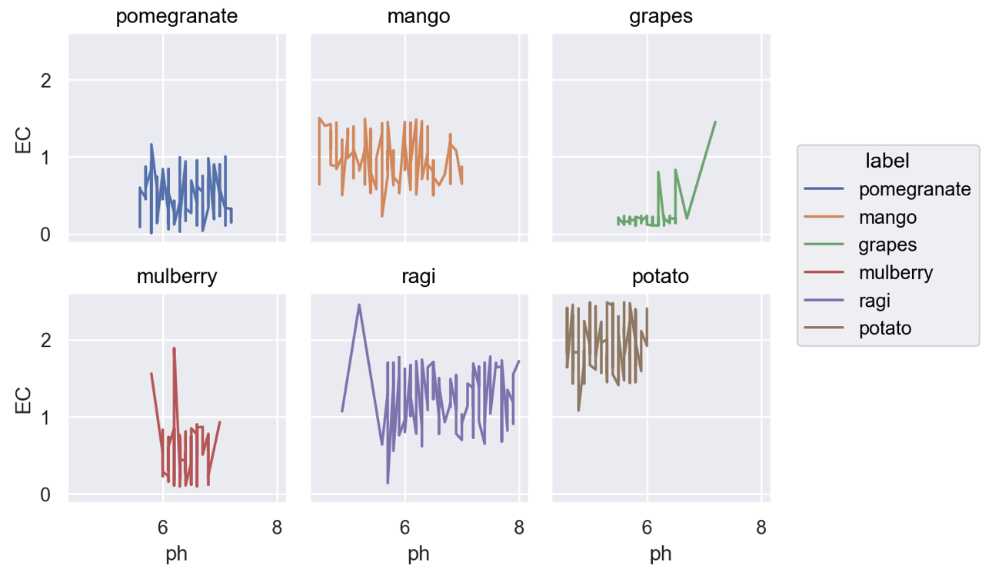
Visualizations
16

Slide 19
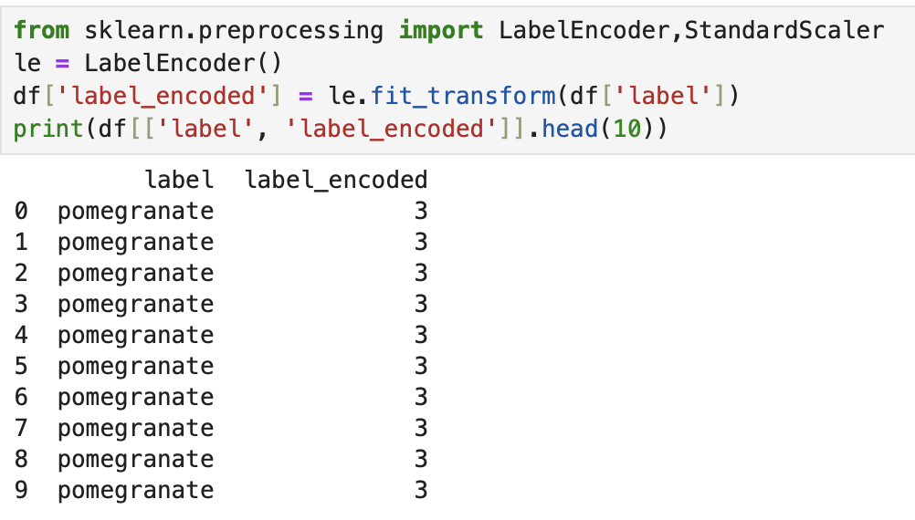
Label Encoding
Visualizations
17

Slide 20
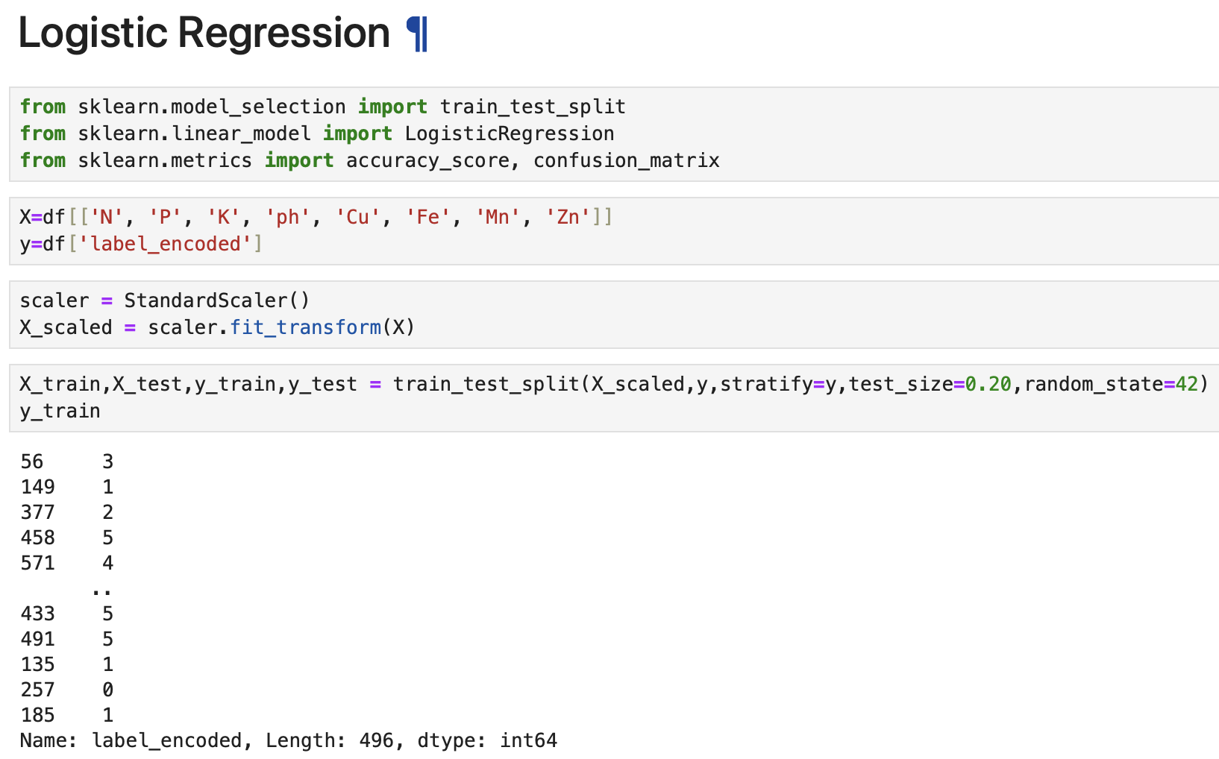
Visualizations
Model Implementation
Label Encoding
18

Slide 21
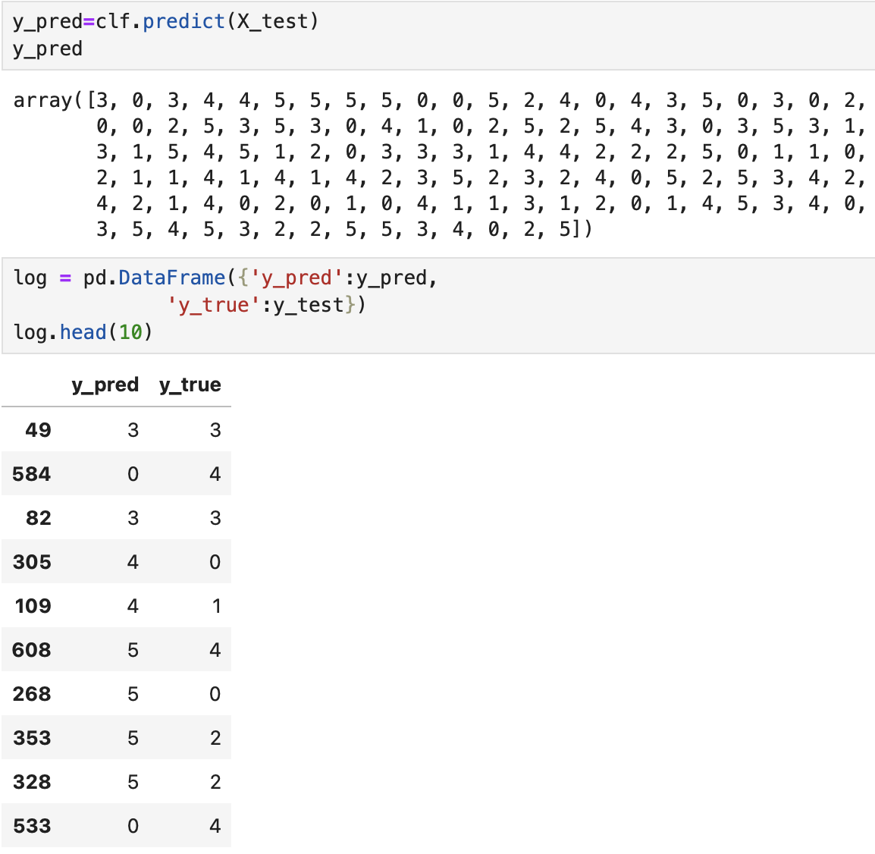
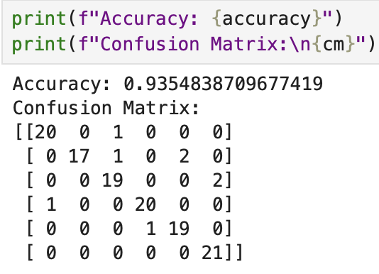
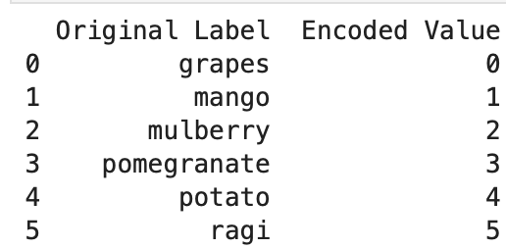
Label Encoding
Model Implementation
19

Slide 22
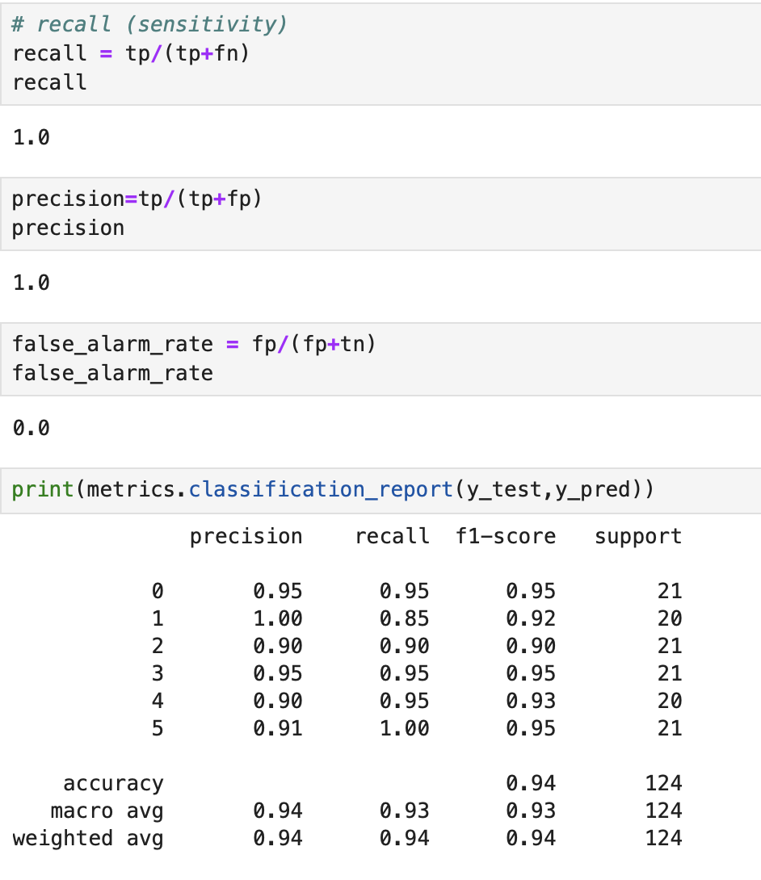
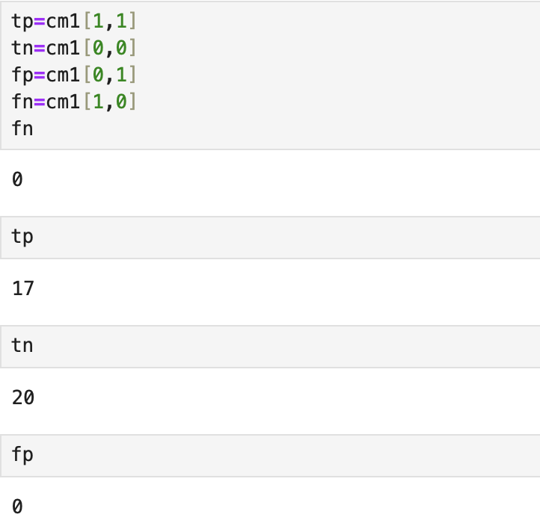
Model Implementation
20

Slide 23
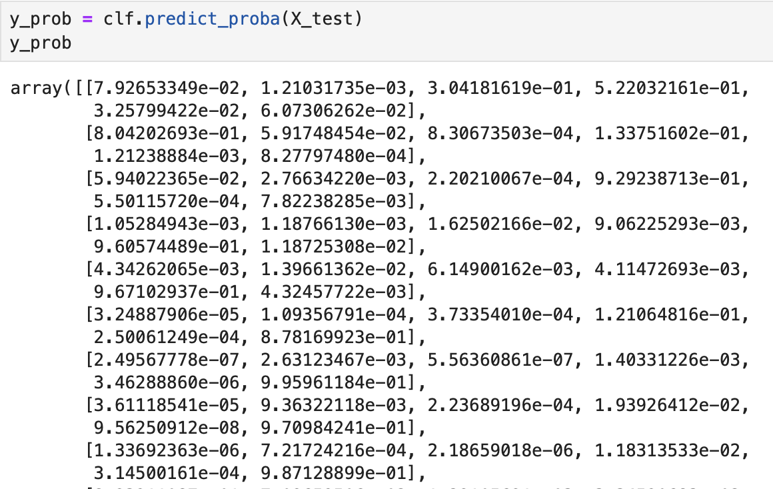
Model Implementation
21

Slide 24
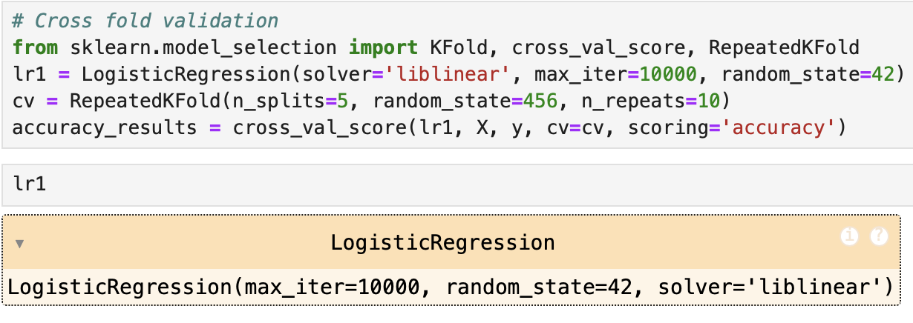
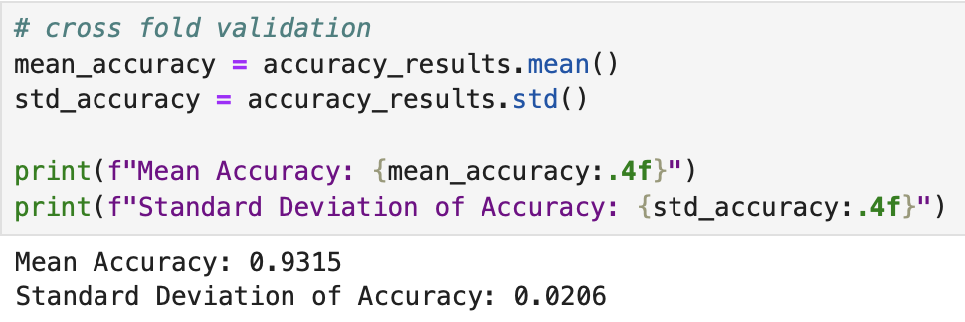
Model Implementation
22

Slide 25
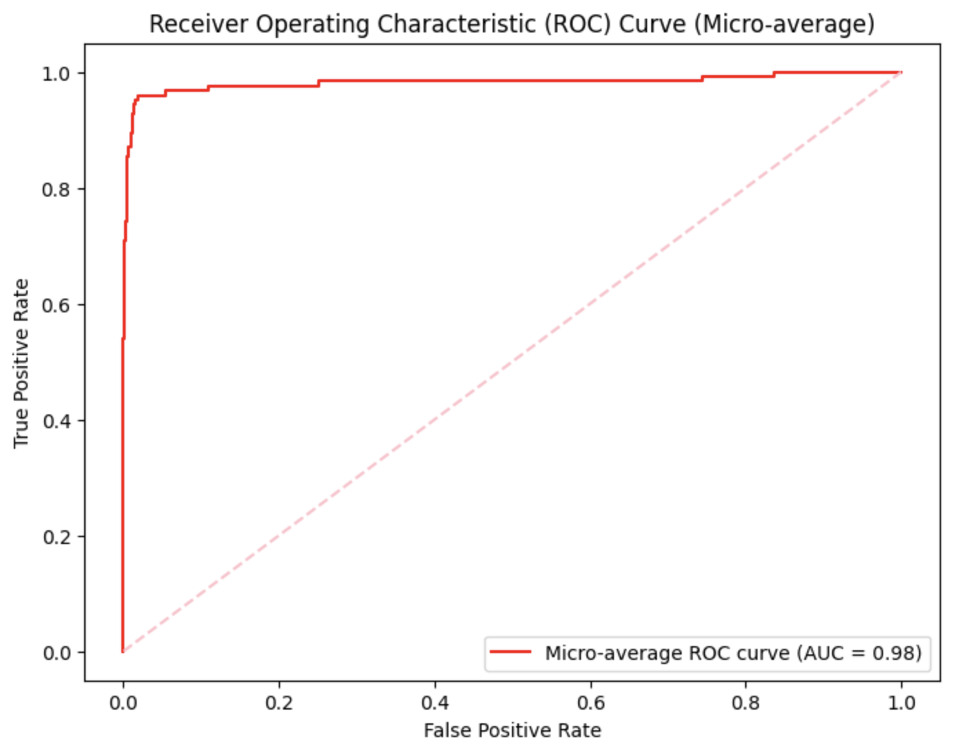
Model Implementation
23

Slide 26

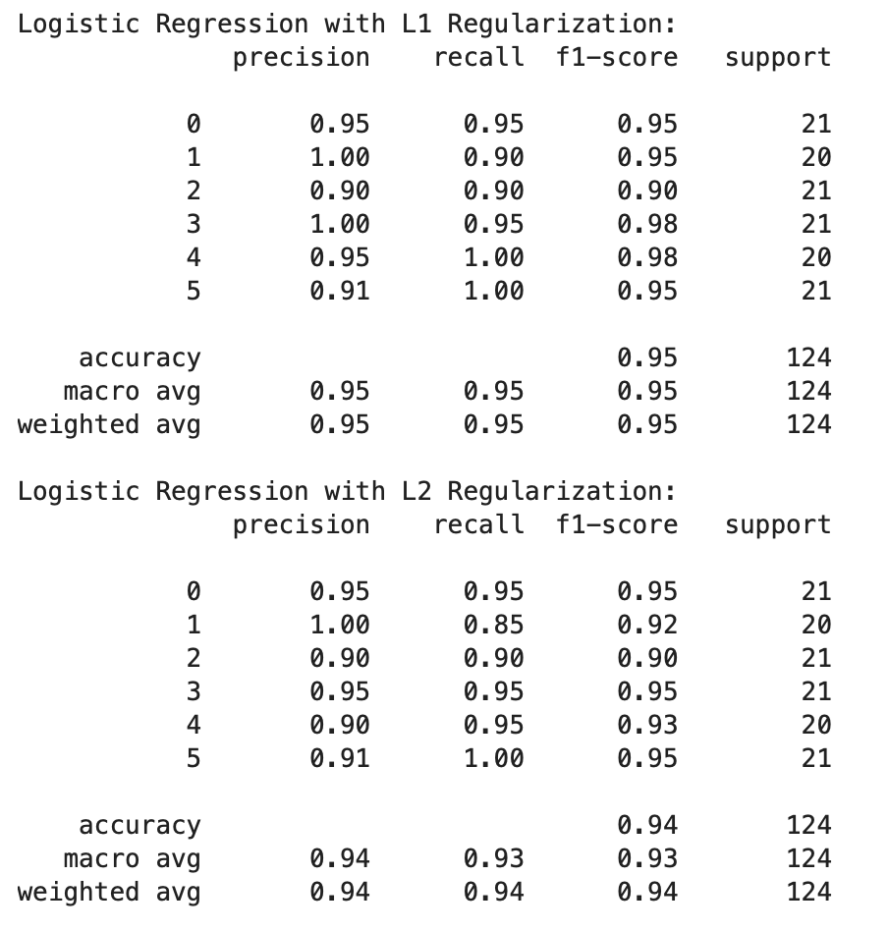
Model Implementation
24

Slide 27
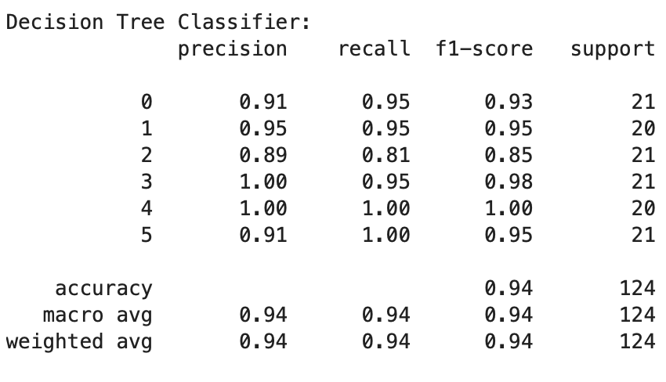
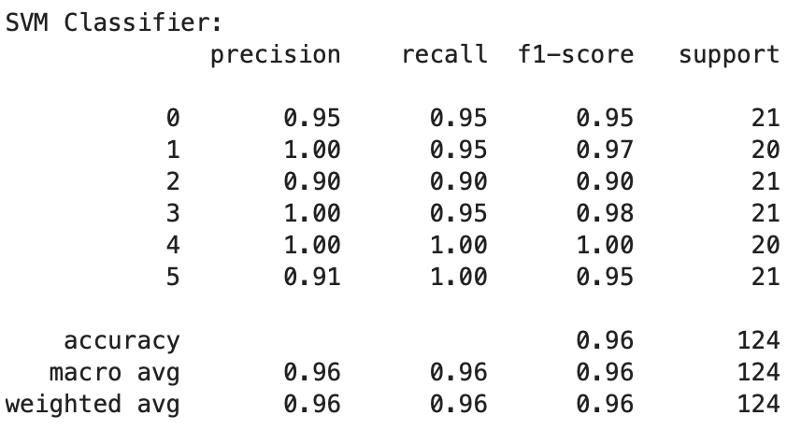
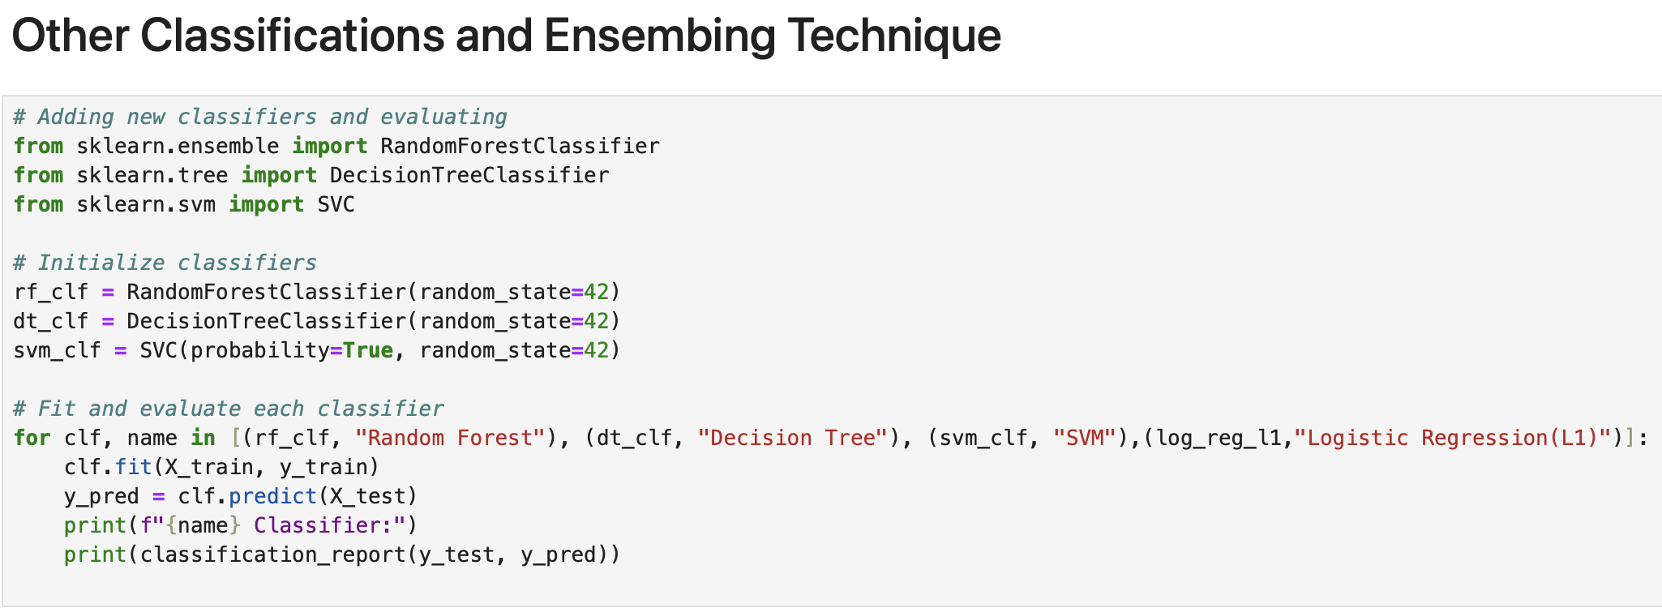
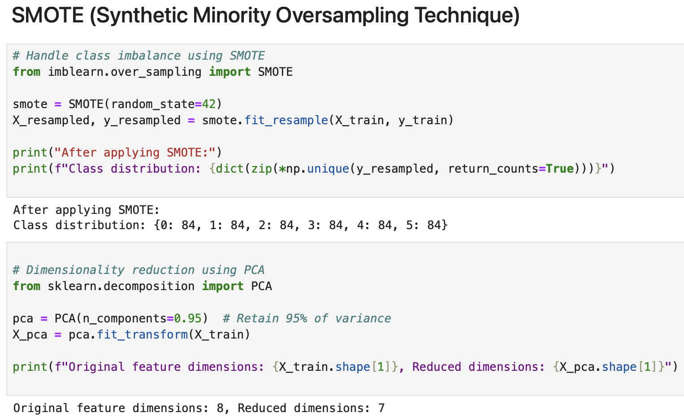
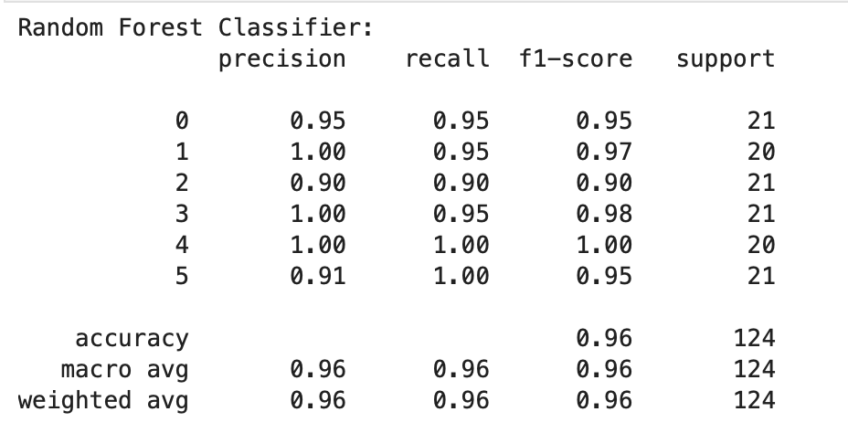
Model Implementation
25

Slide 28
Model Implementation
26

Slide 29
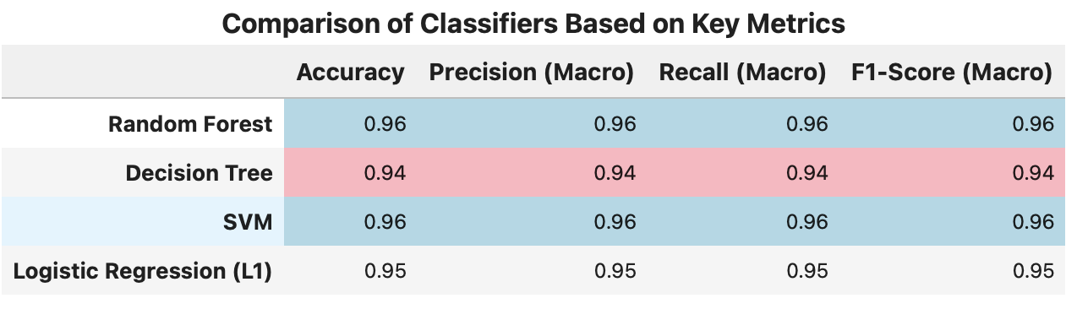
Model Implementation
27

Slide 30
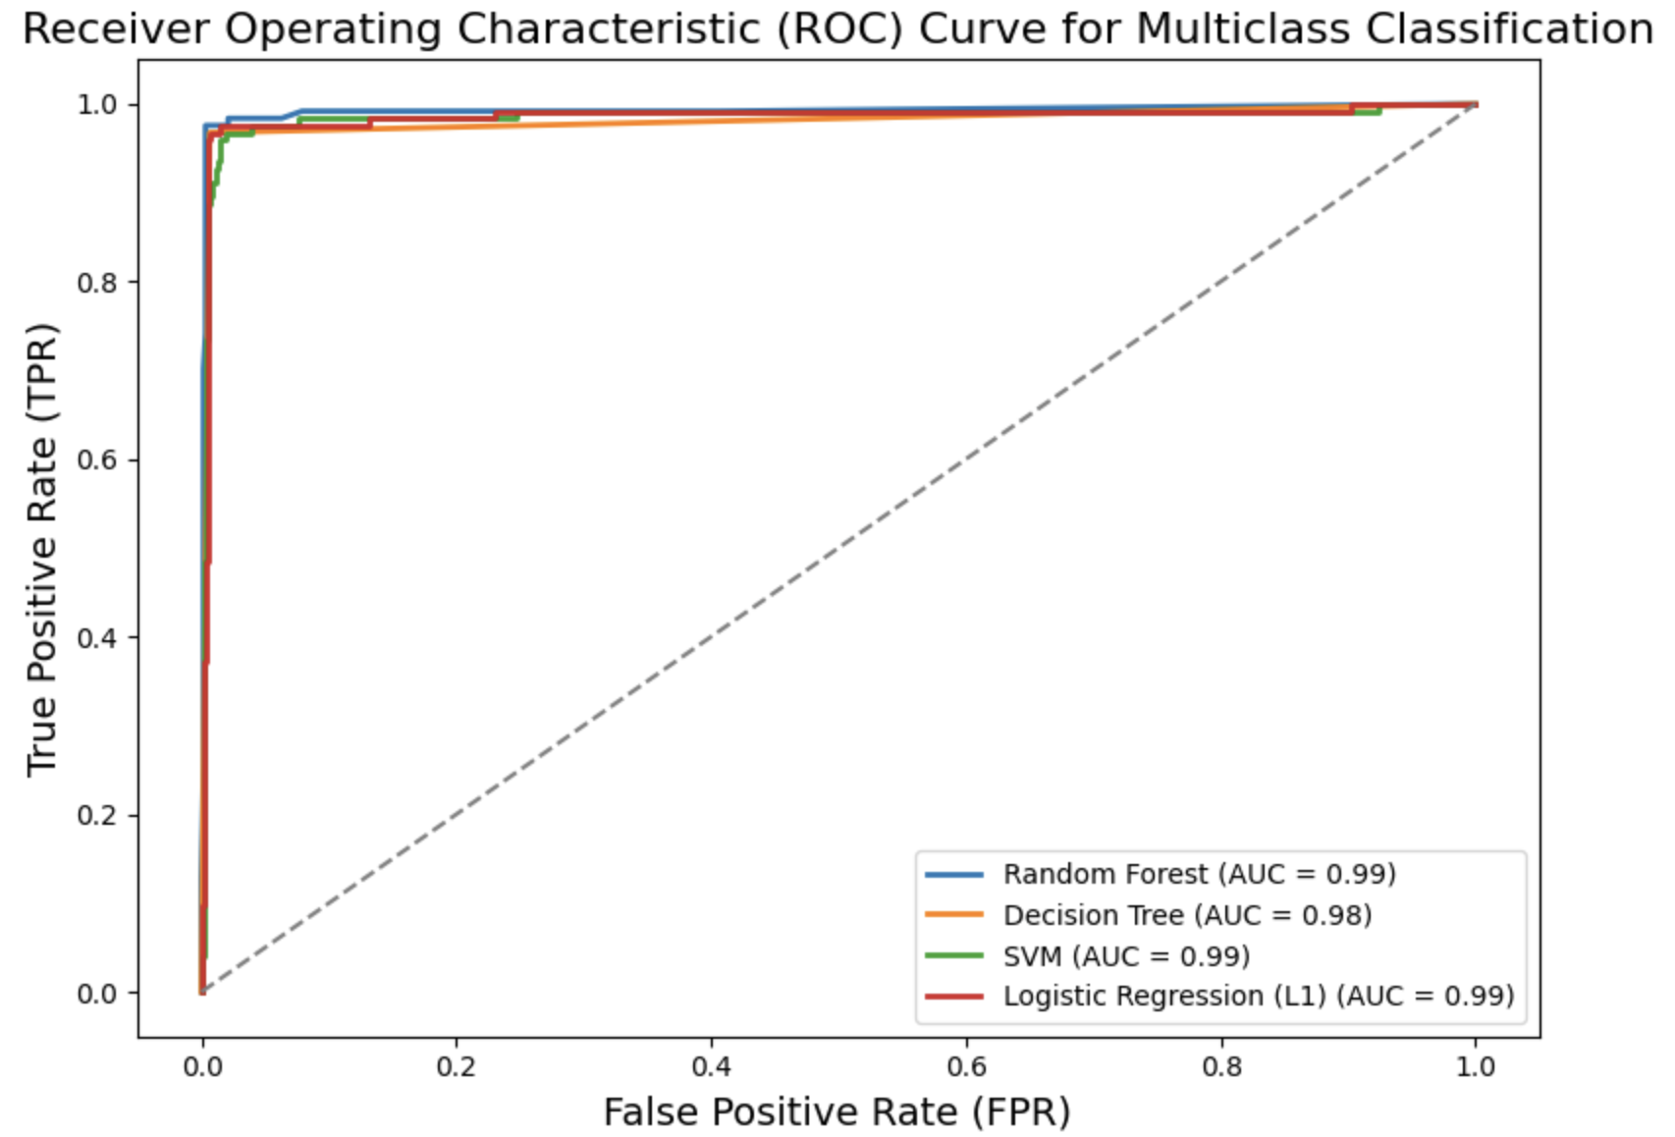
Model Implementation
28

Slide 31
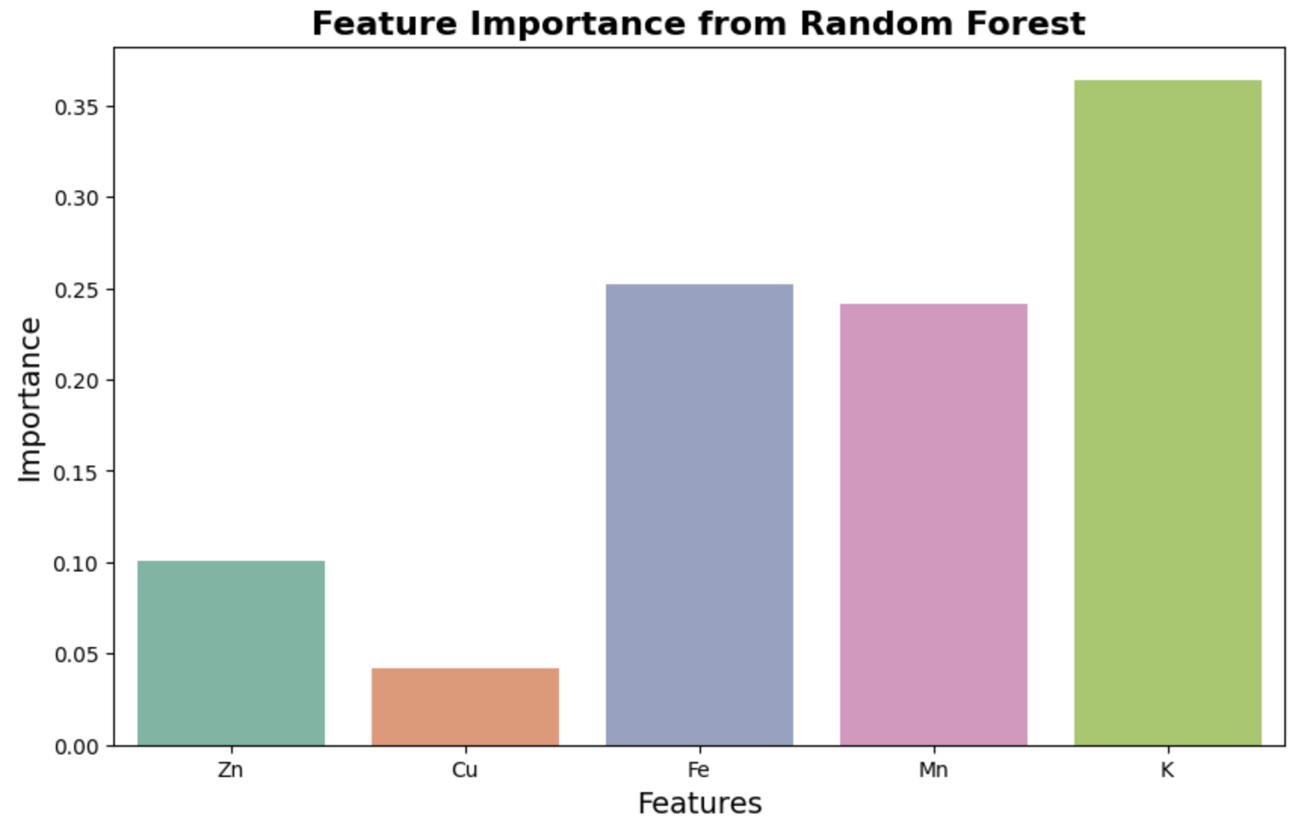
Model Implementation
29

Slide 32
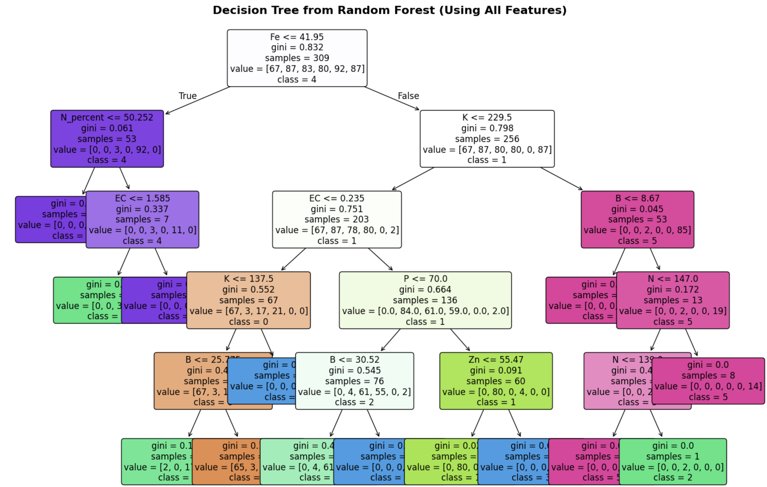
Model Implementation
30

Slide 33
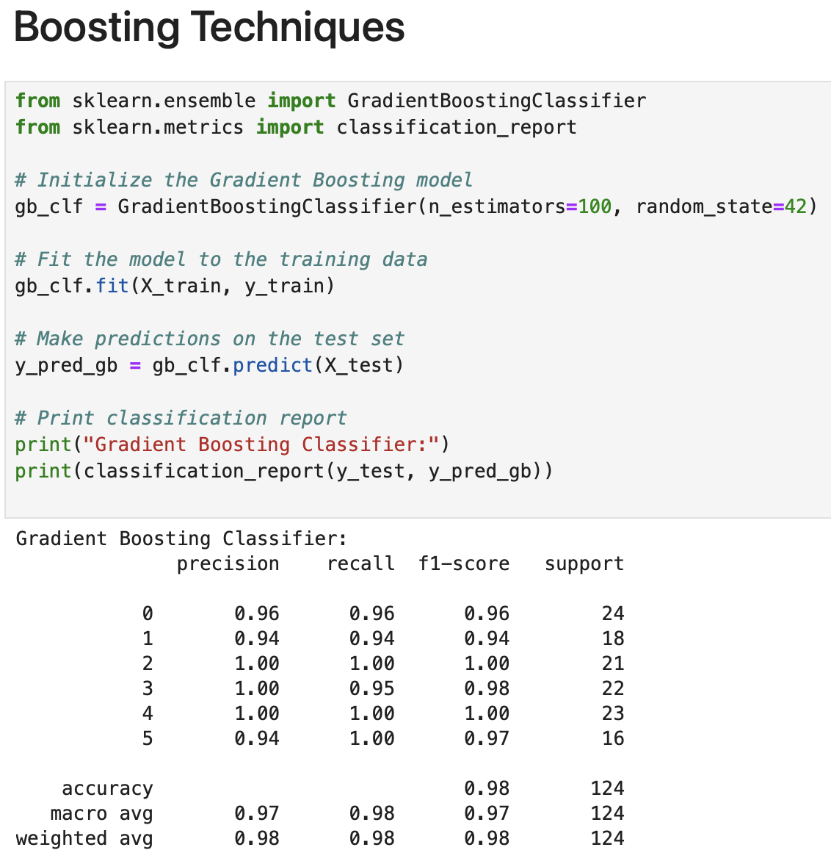
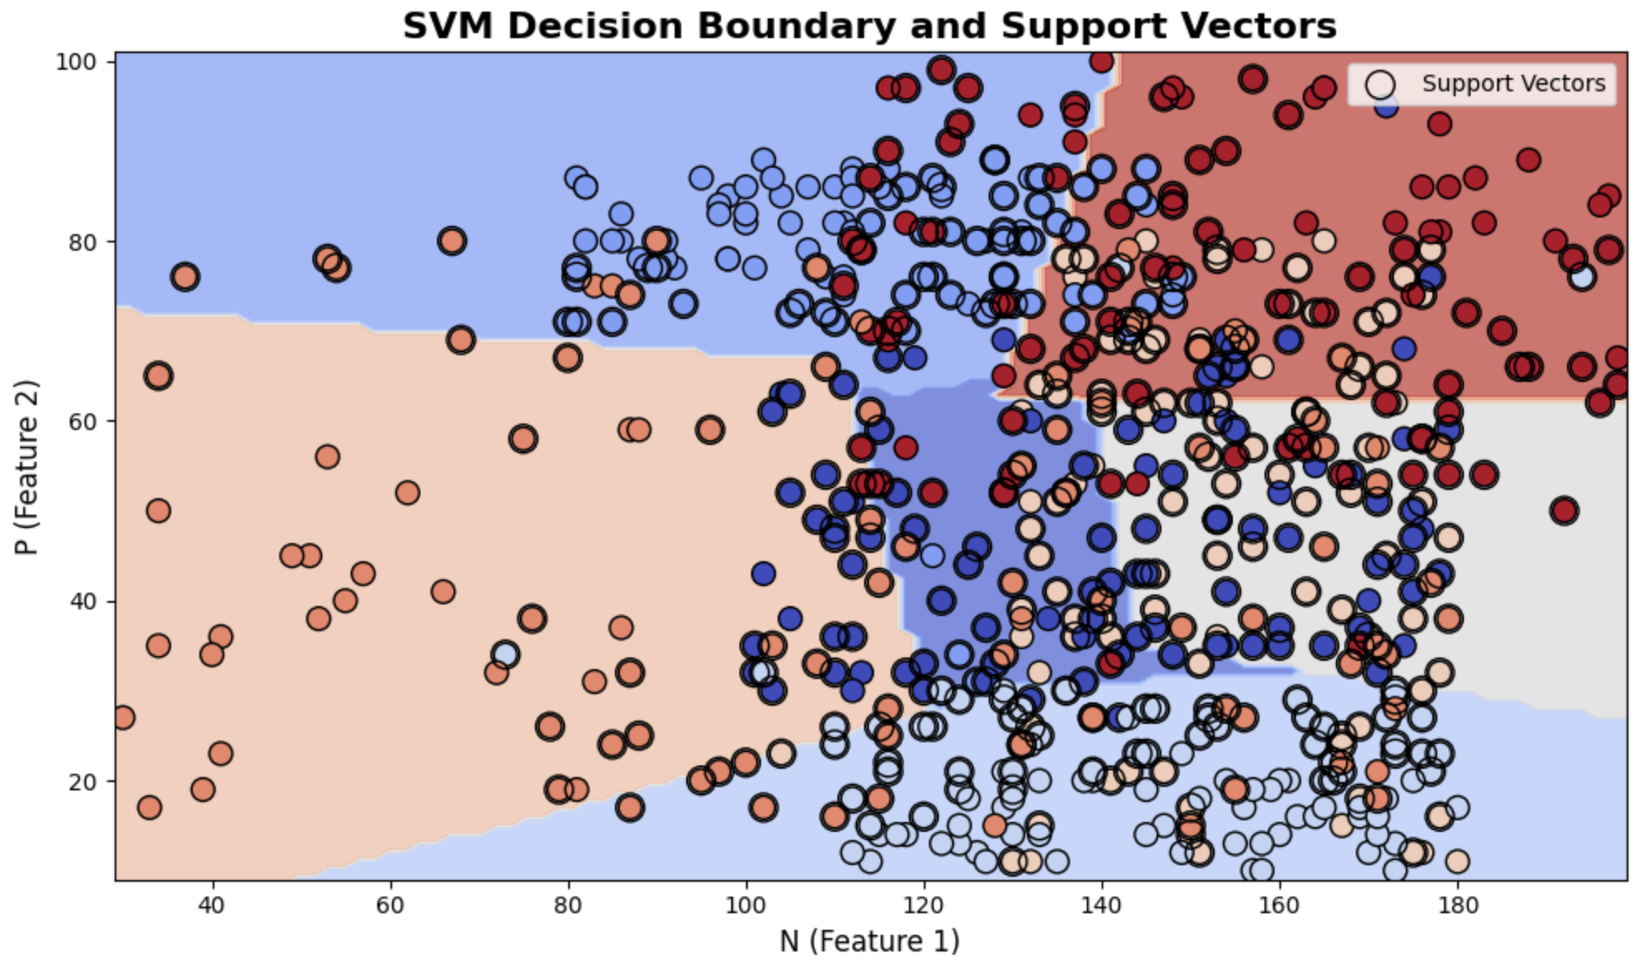
Model Implementation
31

Slide 34
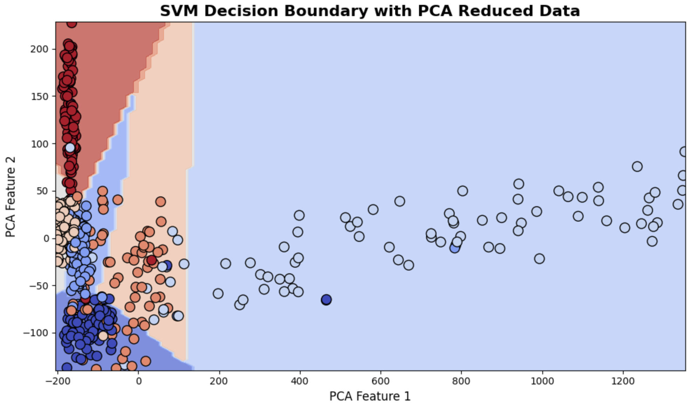
Model Implementation
32

Slide 35
Model Implementation
33

Slide 36
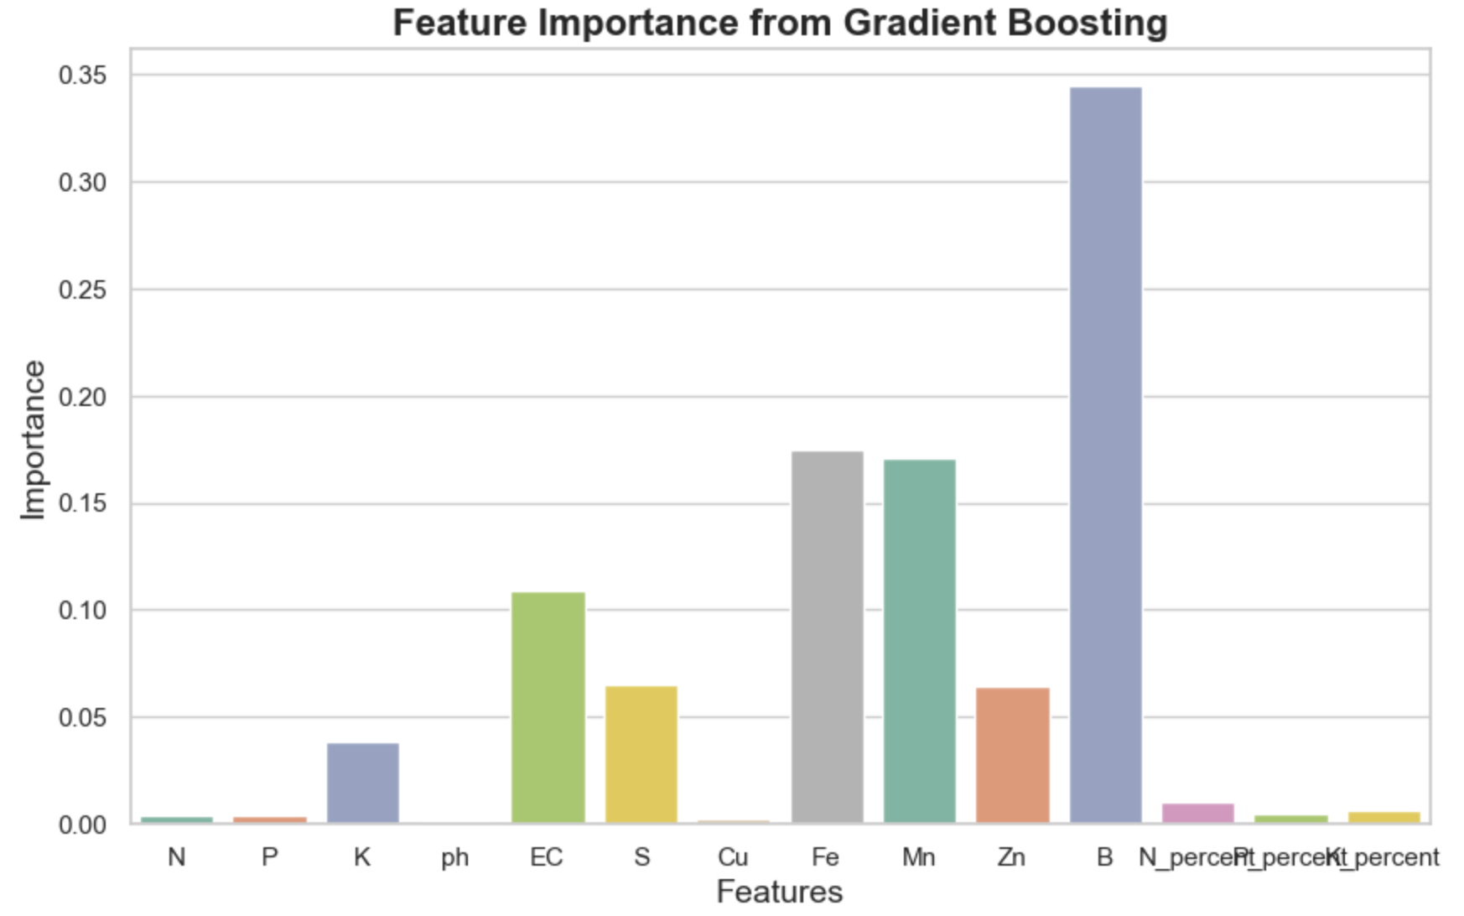
Model Implementation
34

Slide 37
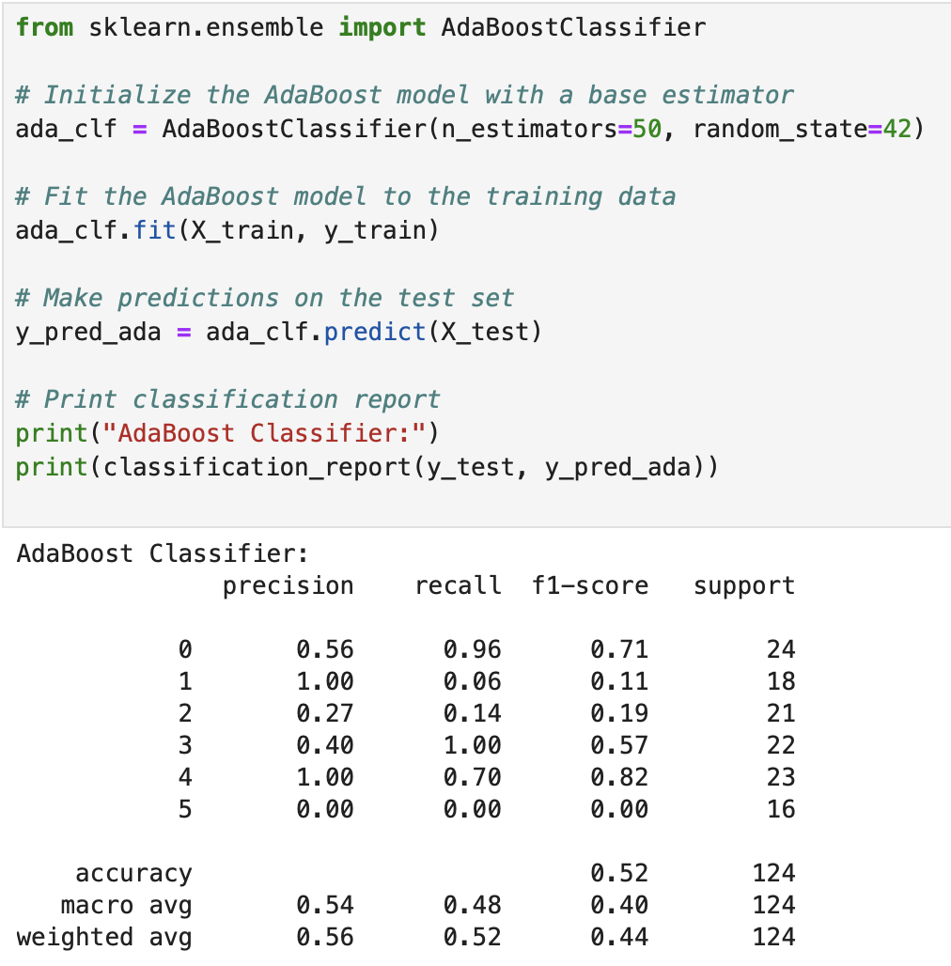
Model Implementation
35

Slide 38
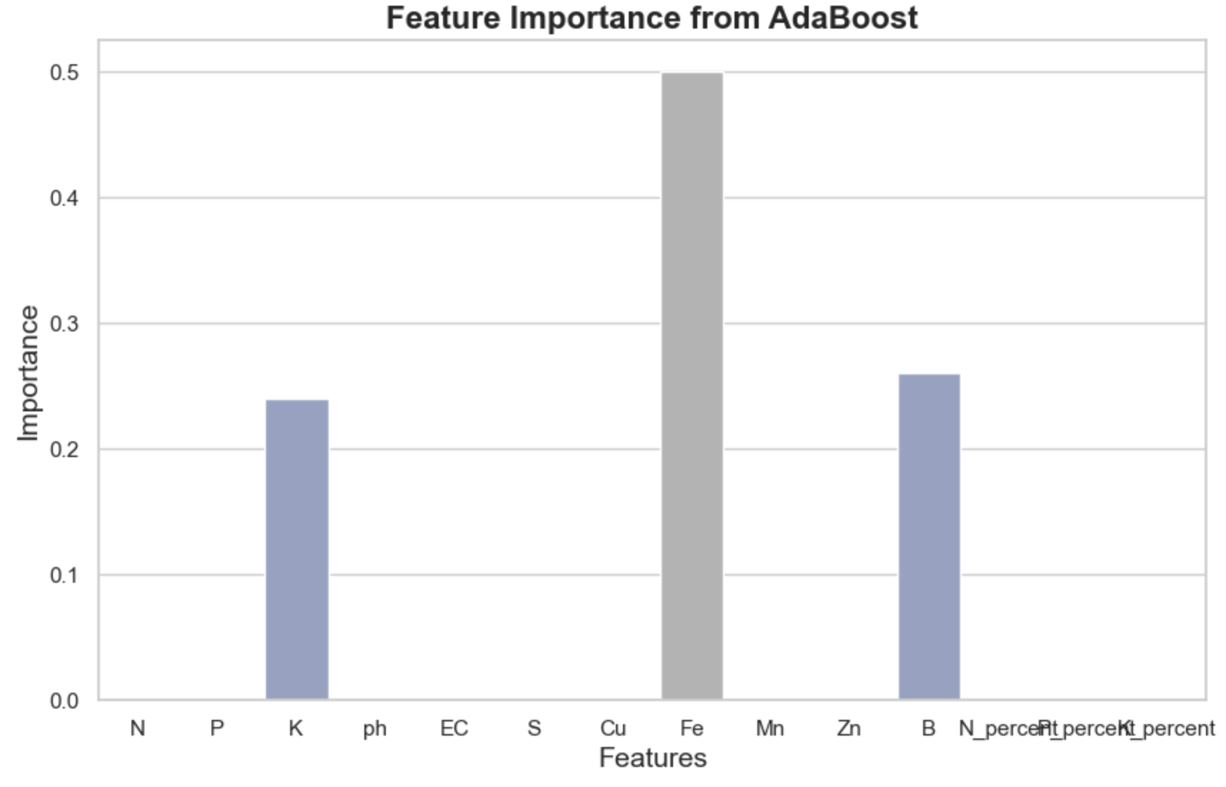
Model Implementation
36

Slide 39
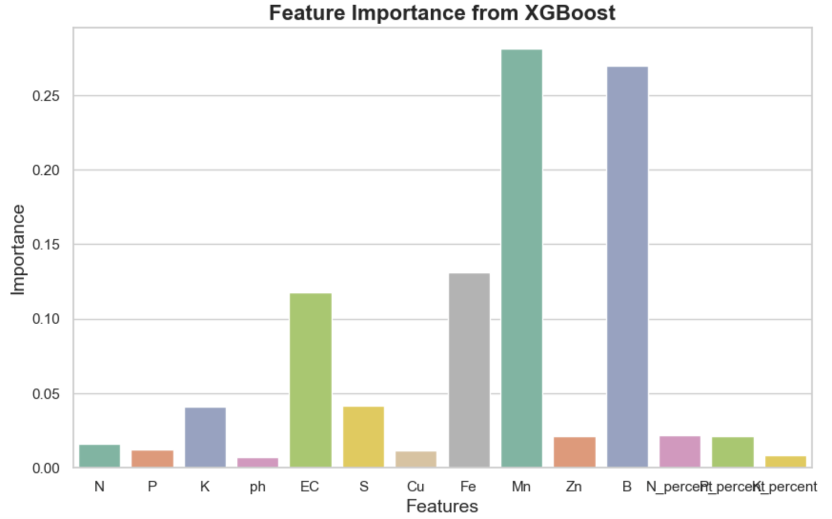
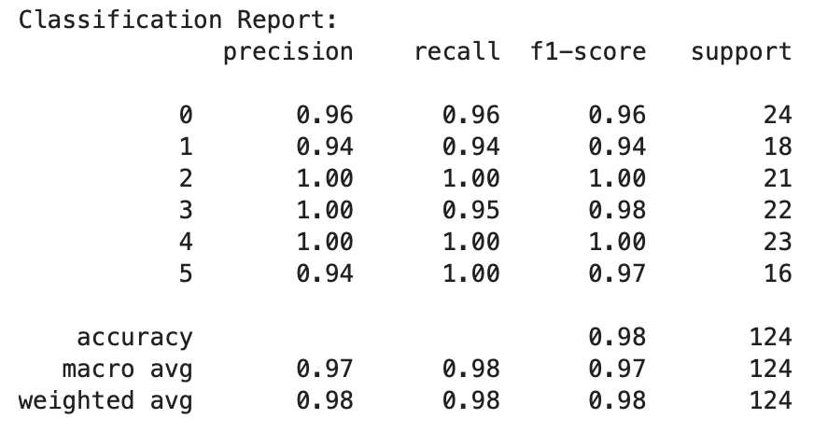

Model Implementation
37

Slide 40
User-Friendly Interface: Develop a mobile or web application for farmers to input soil data and get actionable recommendations easily.
Incorporating external data, such as weather forecasts or satellite imagery, to provide more comprehensive recommendations
01
02
Model Implementation
Future Enhancement
38
03
04
Localized Models: Develop region-specific models tailored to local climate, soil, and crop patterns for better recommendations.
Geospatial Analysis: Use GIS tools to analyze spatial variations in soil data and recommend region-specific crops.

Slide 41







Future Enhancement
01
Incorporating external data, such as weather forecasts or satellite imagery, to provide more comprehensive recommendations
Thank You
02
User-Friendly Interface: Develop a mobile or web application for farmers to input soil data and get actionable recommendations easily.
03
Geospatial Analysis: Use GIS tools to analyze spatial variations in soil data and recommend region-specific crops.
04
Localized Models: Develop region-specific models tailored to local climate, soil, and crop patterns for better recommendations.
39

Slide 42
Thank You

